Slide 1
GROUP 4
Nguyễn Tài Anh – 22BI13028
Đỗ Bảo Nhi – 22BI13349
Đỗ Trọng Đạt – 22BI13075
Vũ Trọng Bách – 22BI13056

Slide 2
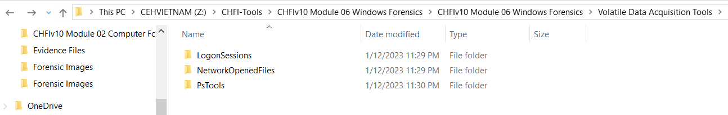
LAB 1 : Acquiring Volatile Information from a Live Windows System
Z:\CHFI-Tools\CHFIv10 Module 06 Windows Forensics\CHFIv10 Module 06 Windows Forensics\Volatile Data Acquisition Tools\PsTools
The above operation will launch Command Prompt displaying the path of PsTools. Type PsLoggedon64.exe and press Enter.
Select the PsTools folder, hold the Shift key on the keyboard, right-click on the selected folder, and then select Open command window here from the context menu.

Slide 3
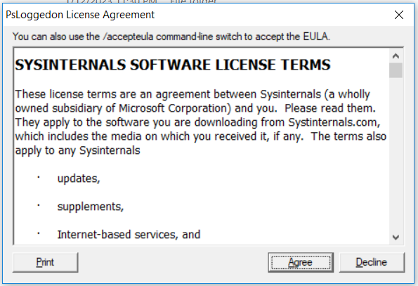
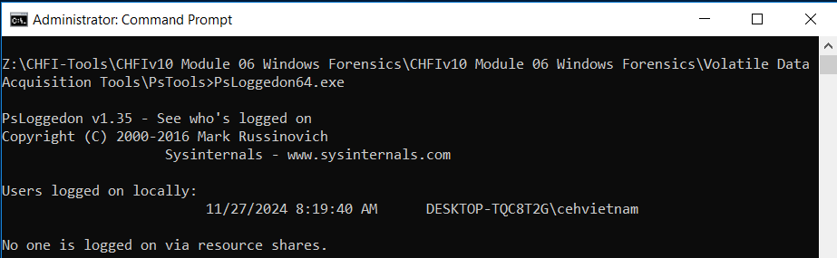
LAB 1 : Acquiring Volatile Information from a Live Windows System
The Command Prompt shows two results: local users (e.g., Administrator) and users via resource shares (none in this case, so it shows null).
The PsLoggedon License Agreement window will appear. Click Agree to continue.

Slide 4
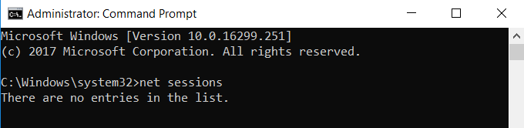
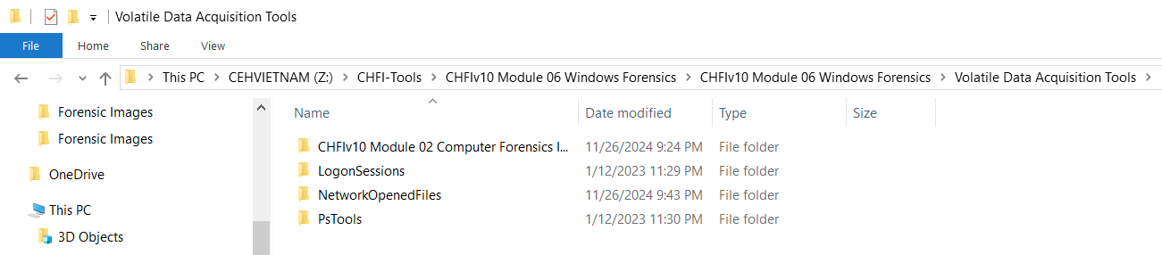
LAB 1 : Acquiring Volatile Information from a Live Windows System
Close the Command Prompt, reopen it as Administrator via the Start button, and run the net sessions command. This will list the IP addresses of connected sessions, including the Windows 10 virtual machine, as shown in the screenshot.
Navigate to C:\CHFI-Tools\CHFIv10 Module 06 Windows Forensics\Volatile Data Acquisition Tools, select the LogonSessions folder, hold the Shift key on the keyboard, right click the selected folder, and select Open command window here from the context menu

Slide 5
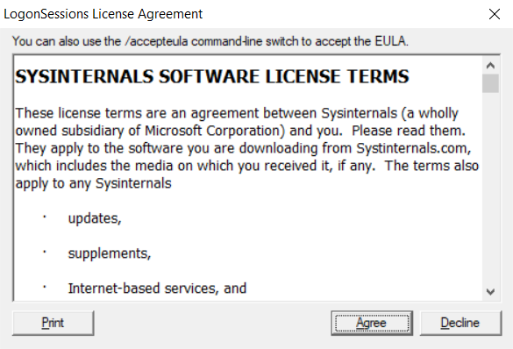
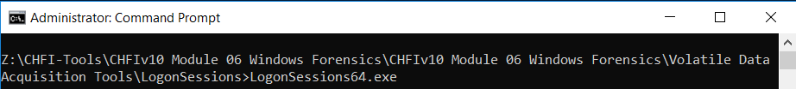
LAB 1 : Acquiring Volatile Information from a Live Windows System
The above operation will launch Command Prompt with the path of LogonSessions. Type LogonSessions64.exe and press Enter
The LogonSessions License Agreement window will appear. Click Agree to continue.

Slide 6
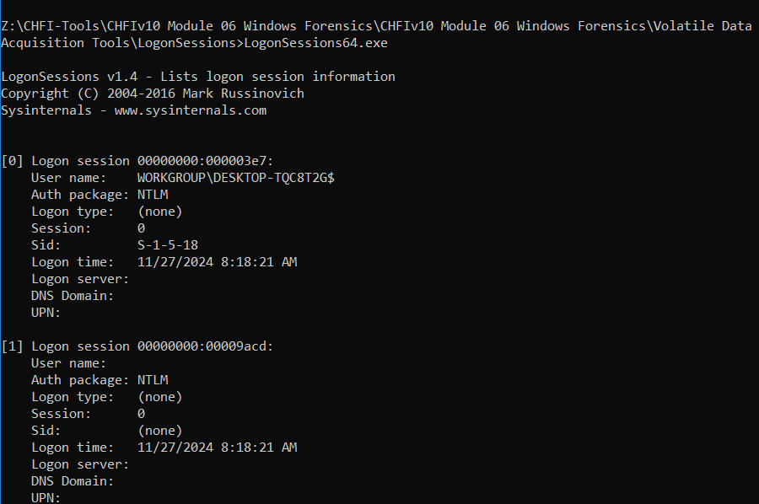
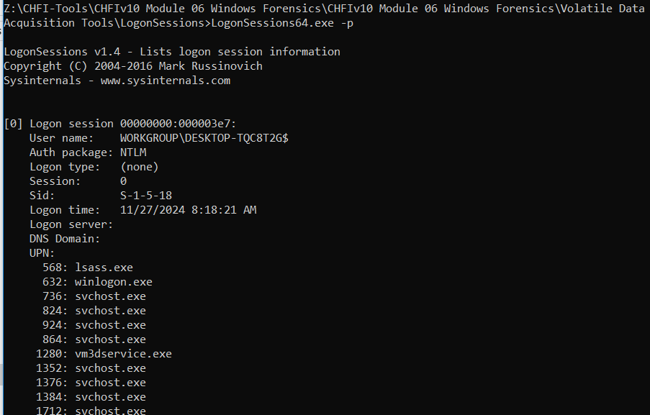
LAB 1 : Acquiring Volatile Information from a Live Windows System
The utility will now list the currently active logon sessions.
To list the logon sessions, their types, and the processes running under them, use the -p switch in combination with LogonSessions64.exe. All the running processes associated with each session will be displayed under the UPN section as shown in the

Slide 7
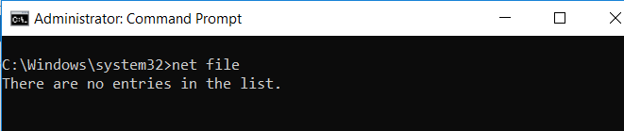
LAB 1 : Acquiring Volatile Information from a Live Windows System
Switch back to Windows Server 2016 virtual machine. To run the net file command, launch command prompt by right clicking the Start button and then clicking Command Prompt (Admin). In the Command Prompt window, type net file and press Enter.
The net file command will now display the Path of the shared folder from the local machine which is accessed by other machines (here, Windows 10 virtual machine); it also displays the Username of the user account that is remotely accessing the shared folder along with the ID and Locks that are associated with the shared folder

Slide 8
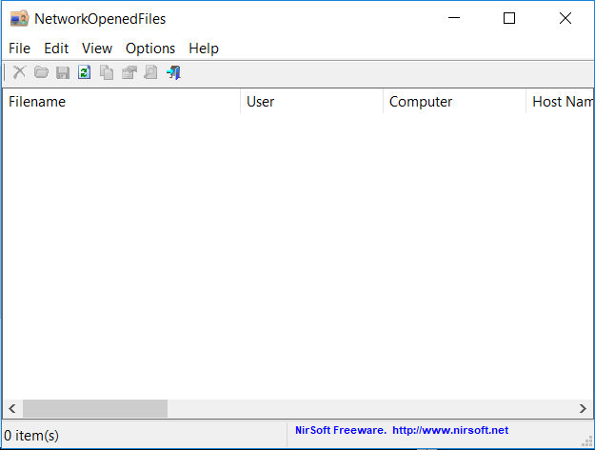
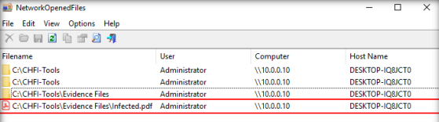
LAB 1 : Acquiring Volatile Information from a Live Windows System
The NetworkOpenedFiles window displays shared folders and files (e.g., CHFI-Tools, Evidence Files, Infected.pdf), along with details such as the remote computer's IP address, user account name, and host name (e.g., the Windows 10 virtual machine). Double-click on C:\CHFI-Tools\Evidence Files\Infected.pdf.
Now, to run NetworkOpenedFiles, switch back to Windows Server 2016 virtual machine, navigate to C:\CHFI-Tools\CHFIv10 Module 06 Windows Forensics\Volatile Data Acquisition Tools\NetworkOpenedFiles, and double-click NetworkOpenedFiles.exe

Slide 9
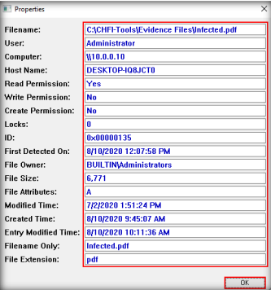
LAB 1 : Acquiring Volatile Information from a Live Windows System
Note: For the demonstrative purpose of this lab, the suspicious file has been represented as Infected.pdf. In the real time, the suspicious file may bear any name.
A Properties window will now open, displaying all the details pertaining to the file Infected.pdf

Slide 10
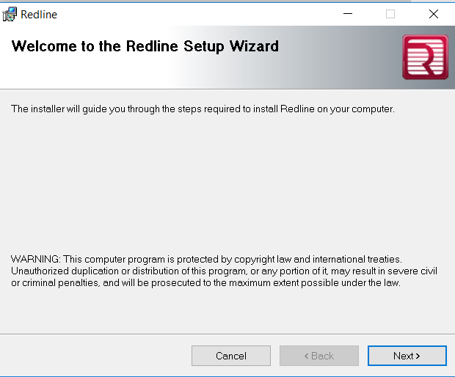
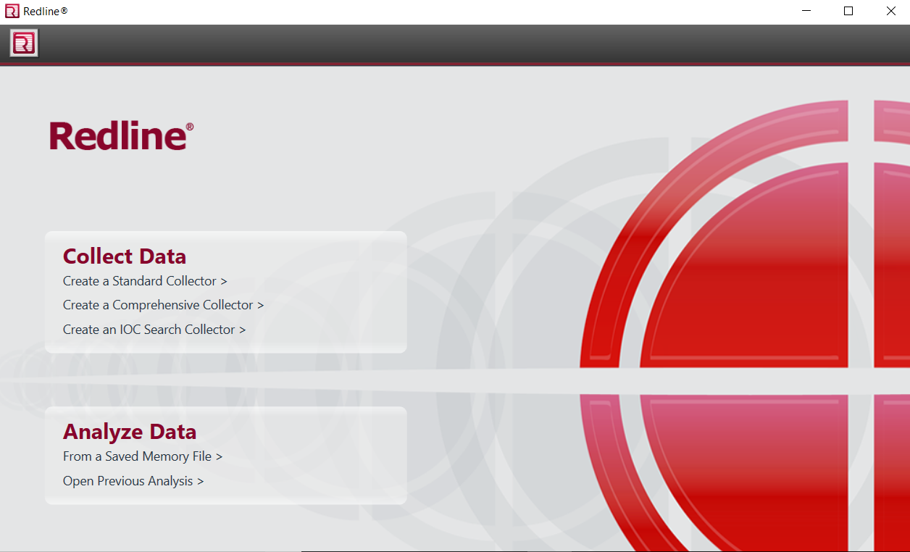
LAB 2 : Investigating Forensic Image of Windows RAM
Navigate to C:\CHFI-Tools\CHFIv10 Module 06 Windows Forensics\Memory Forensics Tools\Redline, double-click Redline2.0.msi, and follow the wizard-driven installation steps to install the application.
The main window of the Redline tool appears. In this lab, we are going to examine a memory image. So, hover the mouse cursor over the Analyze Data section and click From a Saved Memory File.

Slide 11
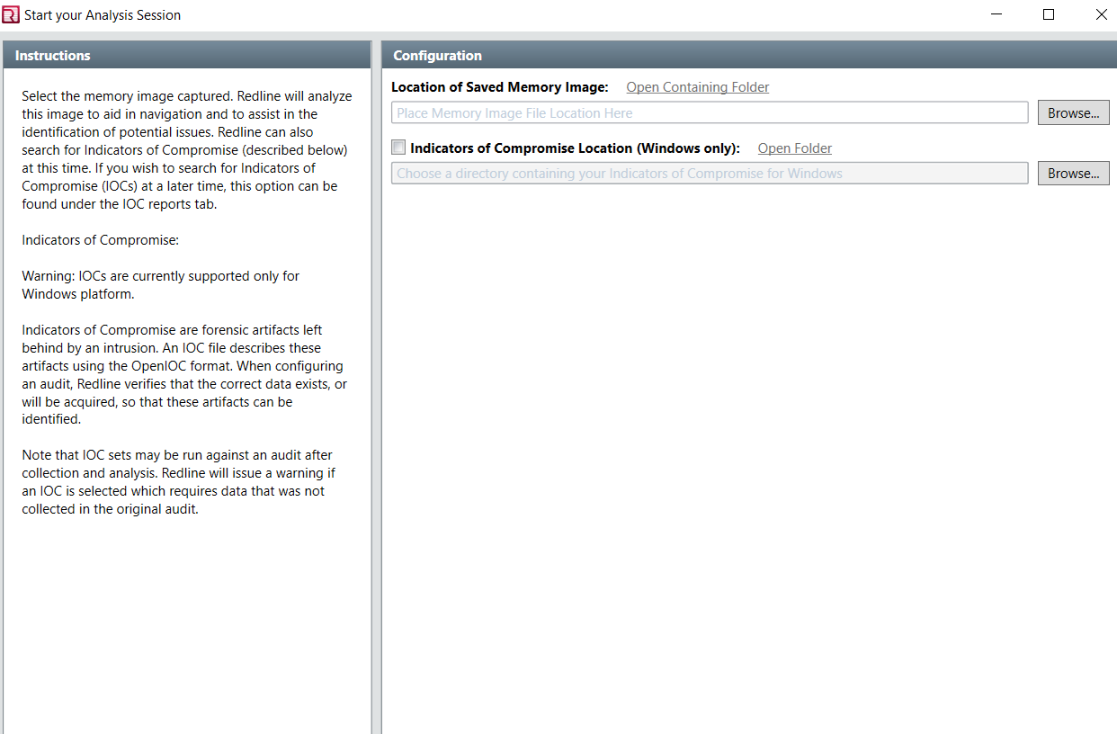
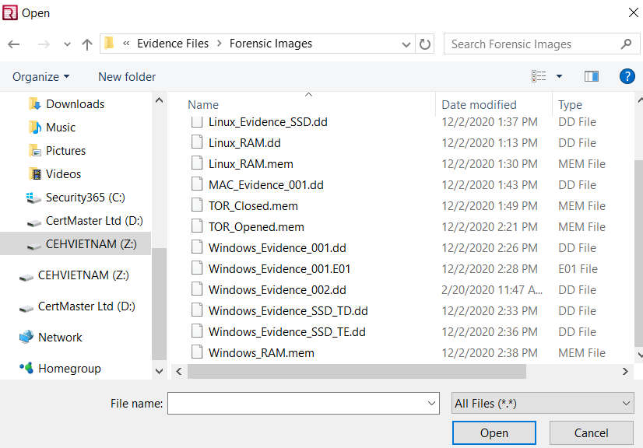
LAB 2 : Investigating Forensic Image of Windows RAM
The Start your Analysis Session window appears. Here, you need to specify the location of the memory image you wish to examine. So, click on the Browse button
The Open window appears. Navigate to C:\CHFI-Tools\Evidence Files\Forensic Images, choose All Files from the file-type dropdown list, select Windows_RAM.mem, and click Open.

Slide 12
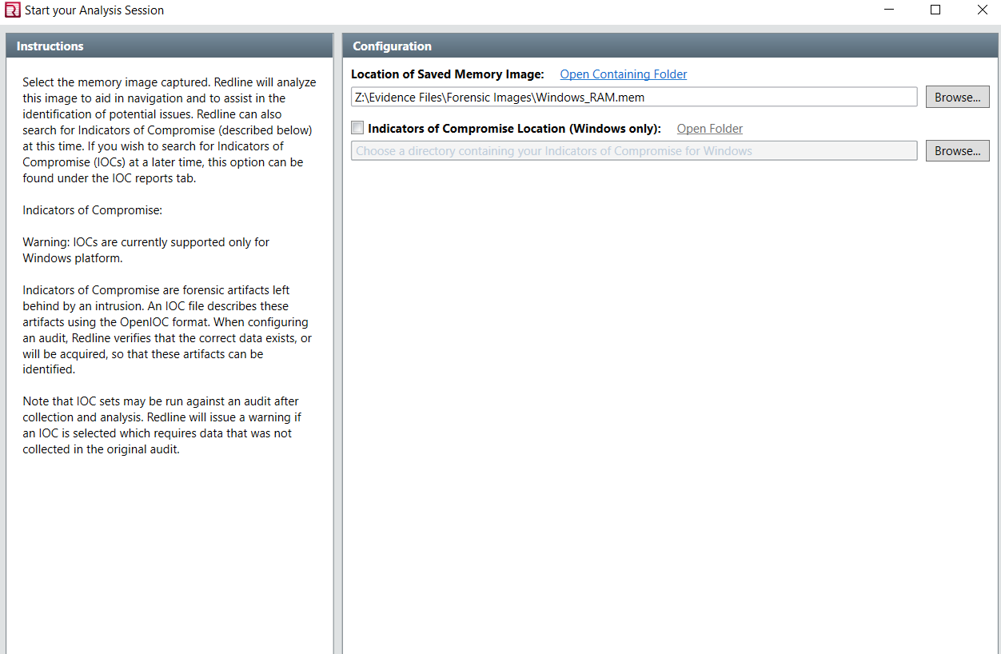
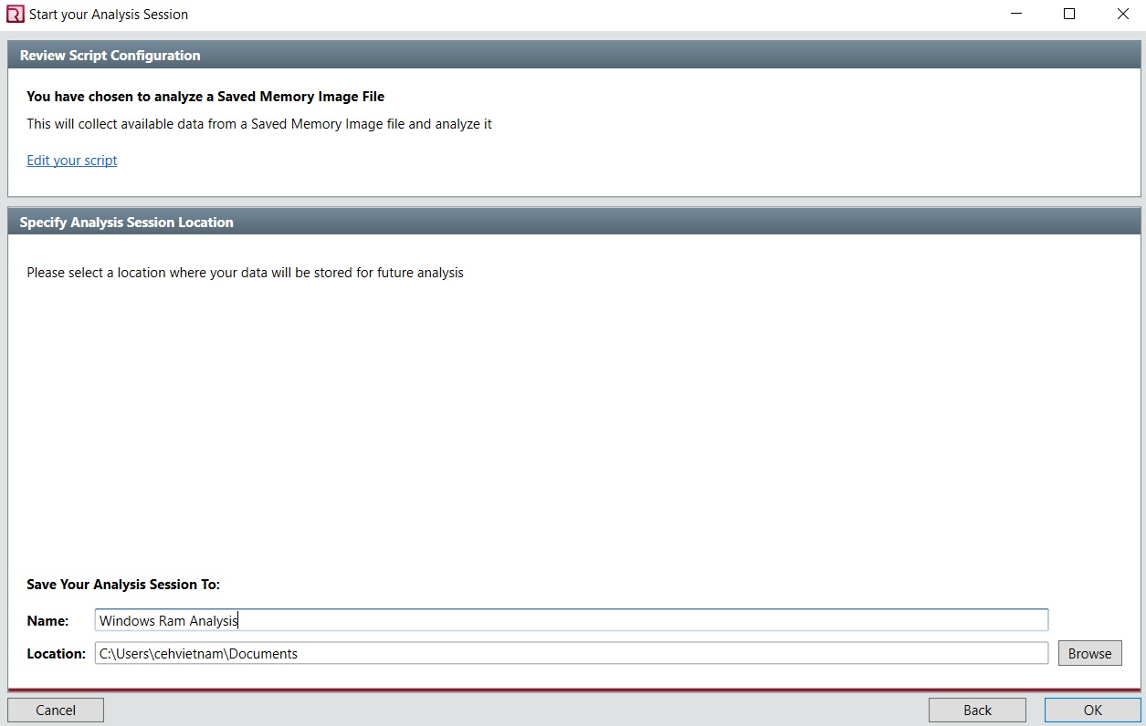
LAB 2 : Investigating Forensic Image of Windows RAM
The file is now set for analysis. Click Next.
In this lab, we are setting the name for the analysis session as Windows Ram Analysis and the location to the default, i.e., C:\Users\Administrator\Documents

Slide 13
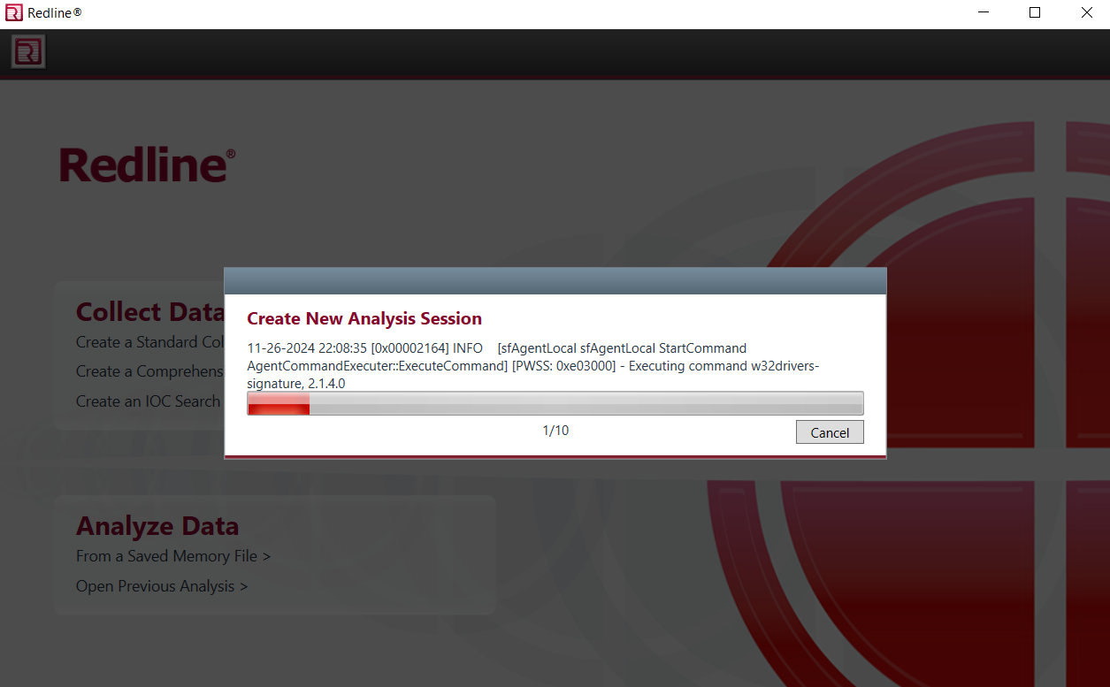
LAB 2 : Investigating Forensic Image of Windows RAM
Redline begins to analyze the image file and takes around 60 minutes to complete the analysis.
Redline begins to analyze the image file and takes around 60 minutes to complete the analysis.

Slide 14
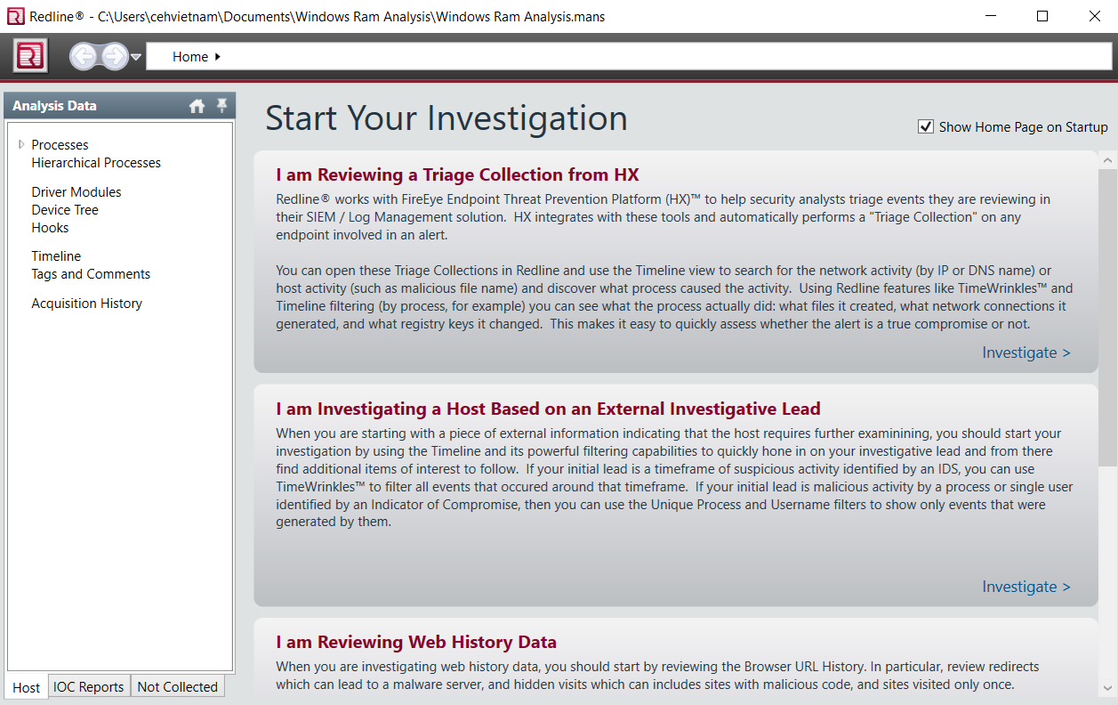
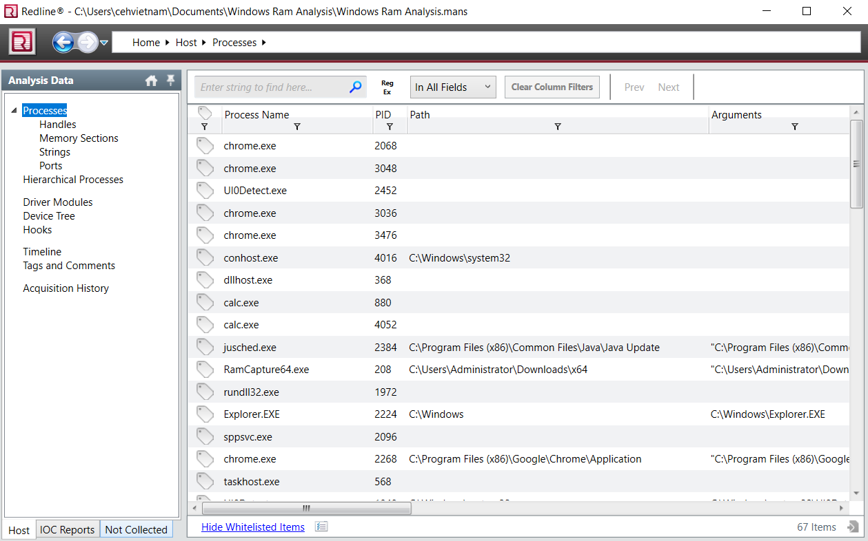
LAB 2 : Investigating Forensic Image of Windows RAM
After creating the analysis session, the following window appears. Double-click Processes in the left pane to view all the processes recorded on the image.
Redline displays all the processes recorded in the RAM.

Slide 15
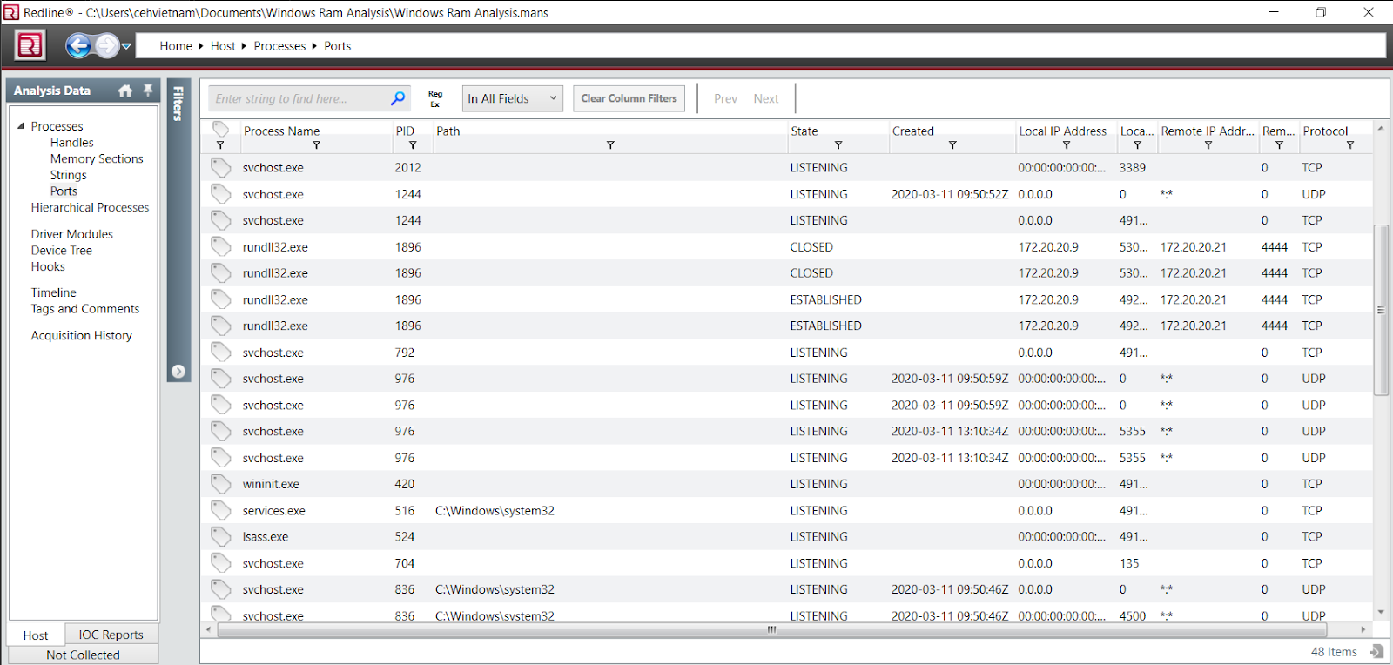
LAB 2 : Investigating Forensic Image of Windows RAM
Click Ports in the left pane. The Ports section appears in the right pane, displaying all the network connections and processes associated with them. Unpin the Filters section for clear visibility of the Ports section.
Examine the Ports section to find any anomalies in the network. You will observe that a process named rundll32.exe is connected to the remote IP 172.20.20.21 on port 4444 and the connection is closed.

Slide 16
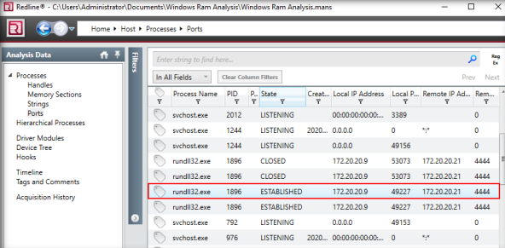
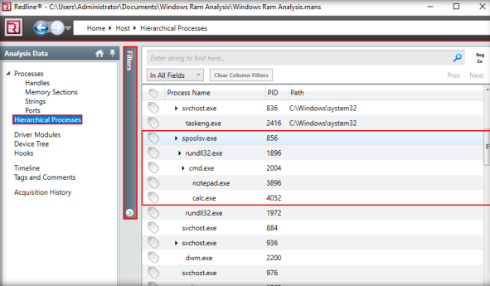
LAB 2 : Investigating Forensic Image of Windows RAM
Scroll down the section to find any other anomalous connections. While scrolling down, you will observe that the same process rundll32.exe exists with PID 1896, which is connected to IP 172.20.20.21 on port 4444, but the connection state is ESTABLISHED and active, which is suspicious.
The Hierarchical Processes section appears in the right pane, displaying the processes in a hierarchy.

Slide 17
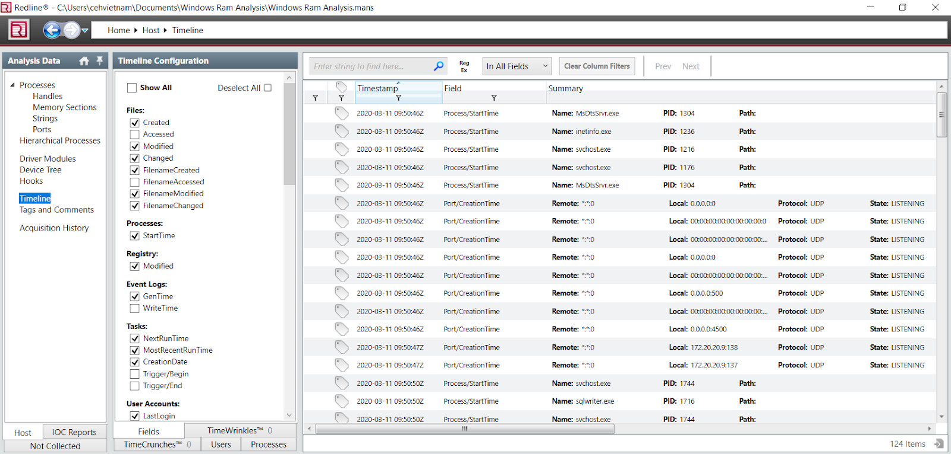
LAB 2 : Investigating Forensic Image of Windows RAM
To view the timeline of the events recorded on the RAM, click Timeline in the left pane.

Slide 18
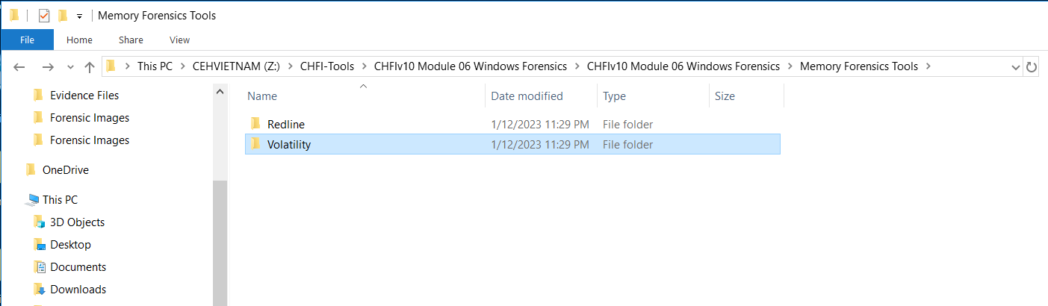
LAB 2 : Investigating Forensic Image of Windows RAM
Navigate to C:\CHFI-Tools\CHFIv10 Module 06 Windows Forensics\Memory Forensics Tools, select Volatility folder, hold the Shift key, and right-click the selected folder. Select Open command window here from the context menu.
Command Prompt appears with the path set to C:\CHFI-Tools\CHFIv10 Module 06 Windows Forensics\Memory Forensics Tools\Volatility. In this lab, we will be analyzing Windows_RAM.mem located at C:\CHFITools\Evidence Files\Forensic Images.

Slide 19
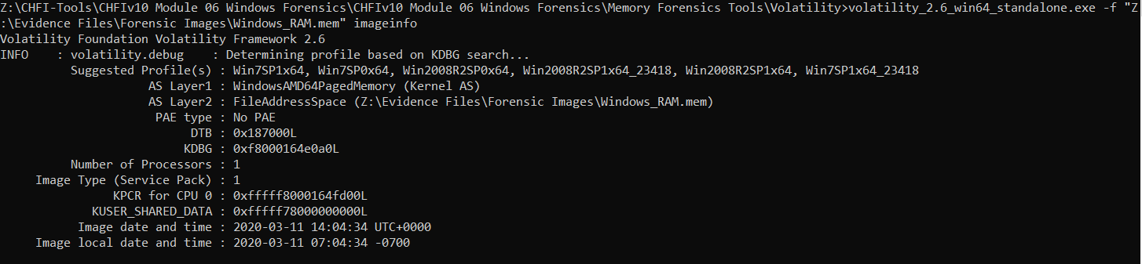
LAB 2 : Investigating Forensic Image of Windows RAM
Our first task is to fetch information about the image. Volatility’s imageinfo plugin helps in retrieving this information. So, type volatility_2.6_win64_standalone.exe -f "Z:\Evidence Files\Forensic Images\Windows_RAM.mem" imageinfo in Command Prompt and press Enter.

Slide 20
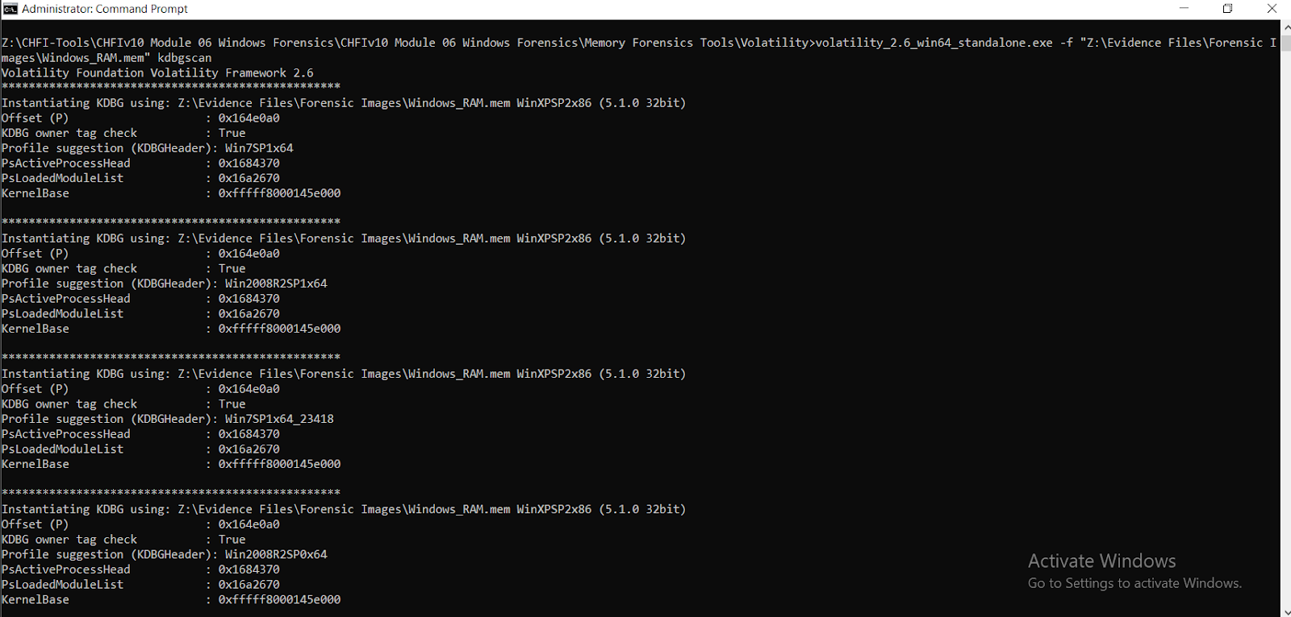
LAB 2 : Investigating Forensic Image of Windows RAM
Alternatively, you can use the kdbgscan plugin to scan the kernel debugger and list the suggested profiles. To use the plugin, type volatility_2.6_win64_standalone.exe -f "Z:\Evidence Files\Forensic Images\Windows_RAM.mem" kdbgscan in Command Prompt and press Enter. Volatility analyzes the kdbg header and lists the possible profiles. Volatility displays a list of suggested profiles. We must choose a profile from the list that could be a close match to the profile on RAM. In this lab, we are going to choose Win2008R2SP0x64.

Slide 21
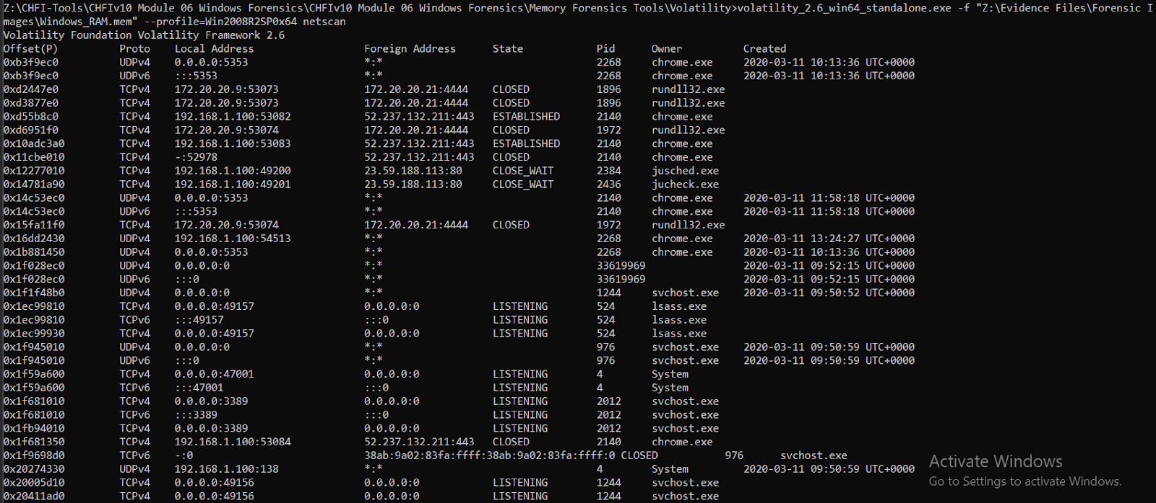
LAB 2 : Investigating Forensic Image of Windows RAM
Since we found a suitable profile, we will now view the network connections associated with the machine that are recorded in the image. To view network connections, type the command volatility_2.6_win64_standalone.exe -f "Z:\Evidence Files\Forensic Images\Windows_RAM.mem" --profile=Win2008R2SP0x64 netscan in Command Prompt and press Enter.

Slide 22
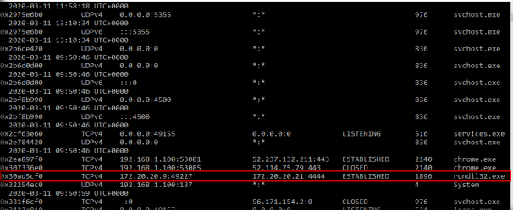
LAB 2 : Investigating Forensic Image of Windows RAM
Scroll down the Command Prompt window to detect any active connection with rundll32.exe. We can observe an active connection by rundll32.exe with PID 1896. From the above screenshot, it can be inferred that the rundll32.exe process has been initiated multiple times. While the connection pertaining to the PID 1972 is closed, the connection with PID 1896 is active. Based on this information, we will conduct further investigation

Slide 23
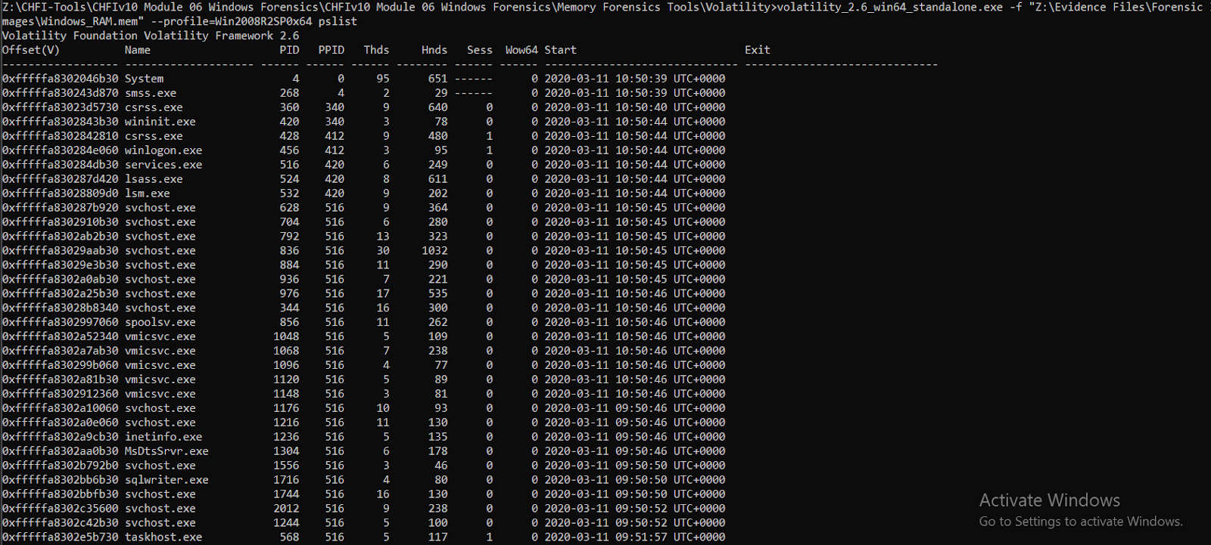
LAB 2 : Investigating Forensic Image of Windows RAM
You can observe the same process in the process list by issuing the following command: volatility_2.6_win64_standalone.exe -f "Z:\Evidence Files\Forensic Images\Windows_RAM.mem" -- profile=Win2008R2SP0x64 pslist.

Slide 24
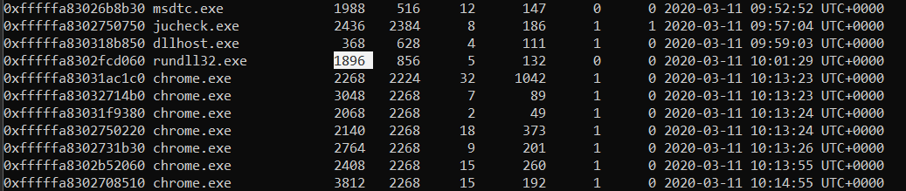
LAB 2 : Investigating Forensic Image of Windows RAM
Scroll down the list to find the rundll32.exe process, which was observed in the network connections listed earlier.

Slide 25
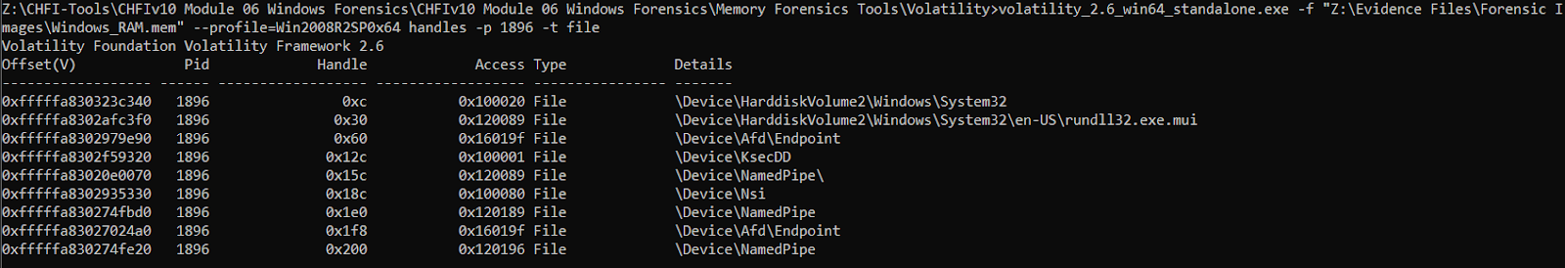
LAB 2 : Investigating Forensic Image of Windows RAM
Based on the process, you can now list the files and registries used by it. To view the files used by the process, type volatility_2.6_win64_standalone.exe -f "Z:\Evidence Files\Forensic Images\Windows_RAM.mem" --profile=Win2008R2SP0x64 handles -p 1896 -t file and press Enter

Slide 26
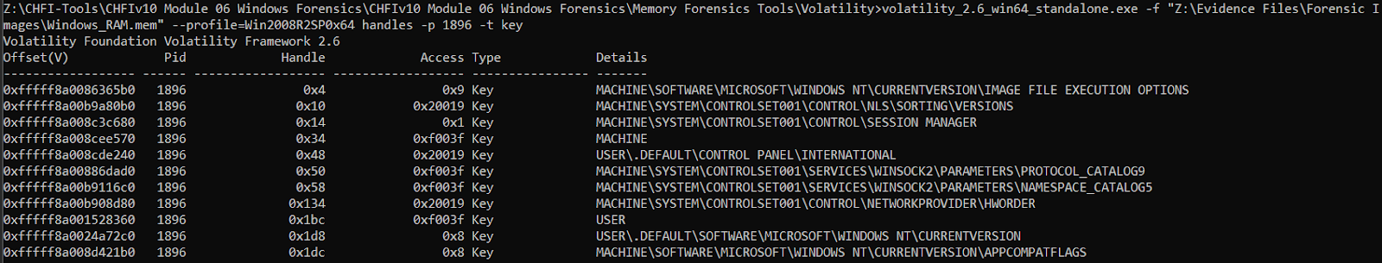
LAB 2 : Investigating Forensic Image of Windows RAM
To view the registries associated with the process, type volatility_2.6_win64_standalone.exe -f "Z:\Evidence Files\Forensic Images\Windows_RAM.mem" --profile=Win2008R2SP0x64 handles -p 1896 -t key and press Enter

Slide 27
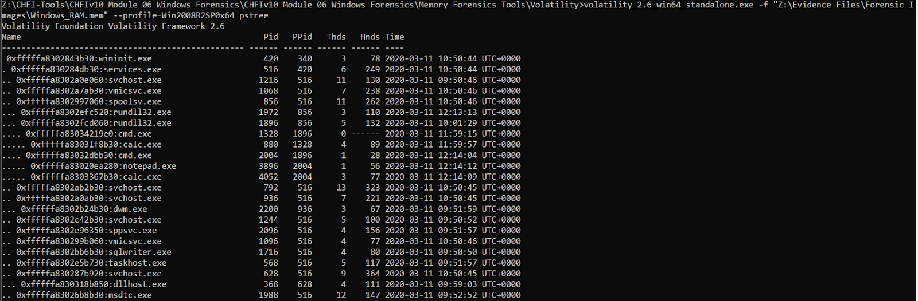
LAB 2 : Investigating Forensic Image of Windows RAM
To list the process tree to which the rundll32.exe process belongs, enter volatility_2.6_win64_standalone.exe -f "Z:\Evidence Files\Forensic Images\Windows_RAM.mem" --profile=Win2008R2SP0x64 pstree. This lists the process tree pertaining to rundll32.exe

Slide 28
Lab 3
Examining Web Browser Artifacts

Slide 29
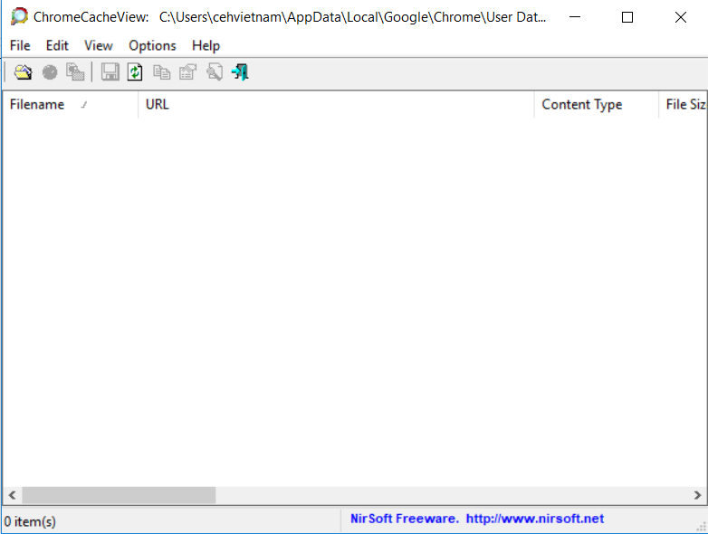
I. View Chrome 1. Chrome Cache
Follow instruction in the labwork slide to start ChromeCacheView.exe
Since Chrome isn’t available in my machine, so the scan display nothing
But if this was in other machines that have chrome, it will display such as Filename, URL, Content Type, File Size, Last Accessed, Expire time, Server Time, Server Name, Server Response, and Server IP Address.

Slide 30
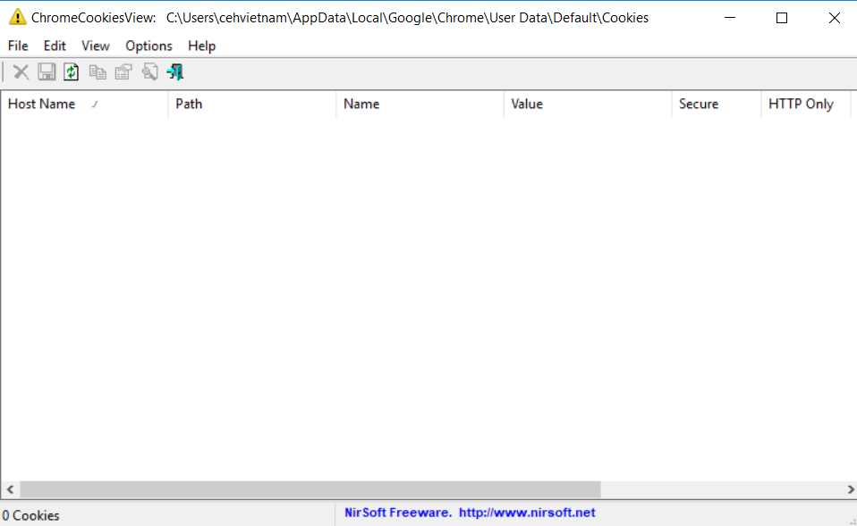
2.Chrome Cookies
Follow instruction in the labwork slide to start ChromeCookiesView.exe
Since Chrome isn’t available in my machine, so the scan display nothing
But if this was in other machines that have chrome, it will display such as Host Name, Path, Name, Value, Secure, HTTP Only, Last Accessed, etc. for each visited web page.

Slide 31
3. Chrome History
Follow instruction in the labwork slide to start ChromeHistoryView.exe
Since Chrome isn’t available in my machine, so the scan display nothing
But if this was in other machines that have chrome, it will display such as Host Name, Path, Name, Value, Secure, HTTP Only, Last Accessed, etc. for each visited web page.

Slide 32
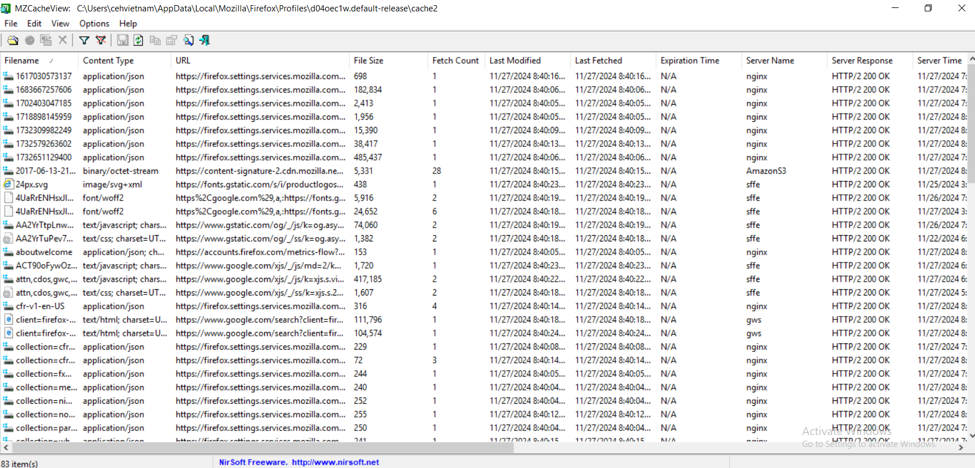
II. View Mozilla FireFox 1. MZ Cache
Follow instruction in the labwork slide to start MZCacheView.exe
MZCacheView displays information such as Filename, Content Type, URL, File Size, Fetch Count, Last Modified, Last Fetched, Expiration Time, Server Name, Server Response, Server Time, Content Encoding, Cache Name, Missing File, Cache Control, etc. for each cache file.

Slide 33
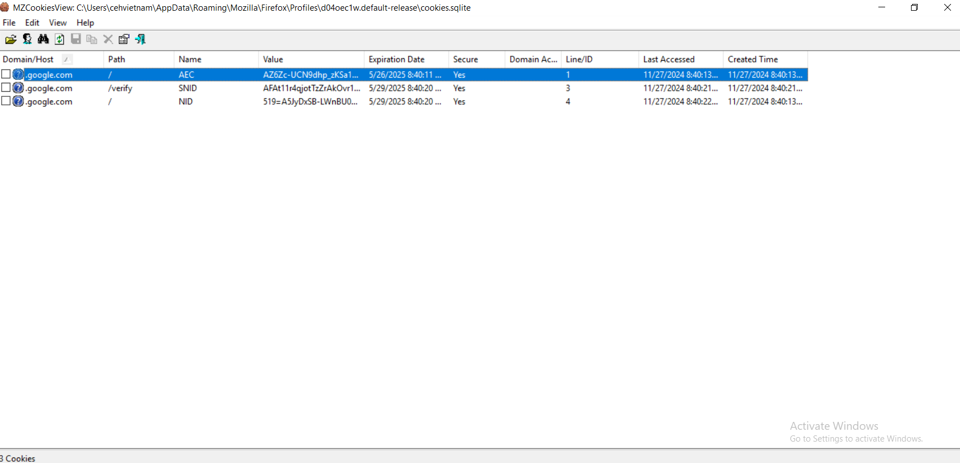
2. MZ Cookies
Follow instruction in the labwork slide to start MZCookiesView.exe
Upon launching, the MZCookiesView application window will appear, displaying a list of all cookies that have been generated by the user’s visits to various websites. It will also display information such as Domain/Host, Path, Name, Value, Expiration Date, Secure (Yes/No), Last Accessed, Created Time, etc. for each cookie.

Slide 34
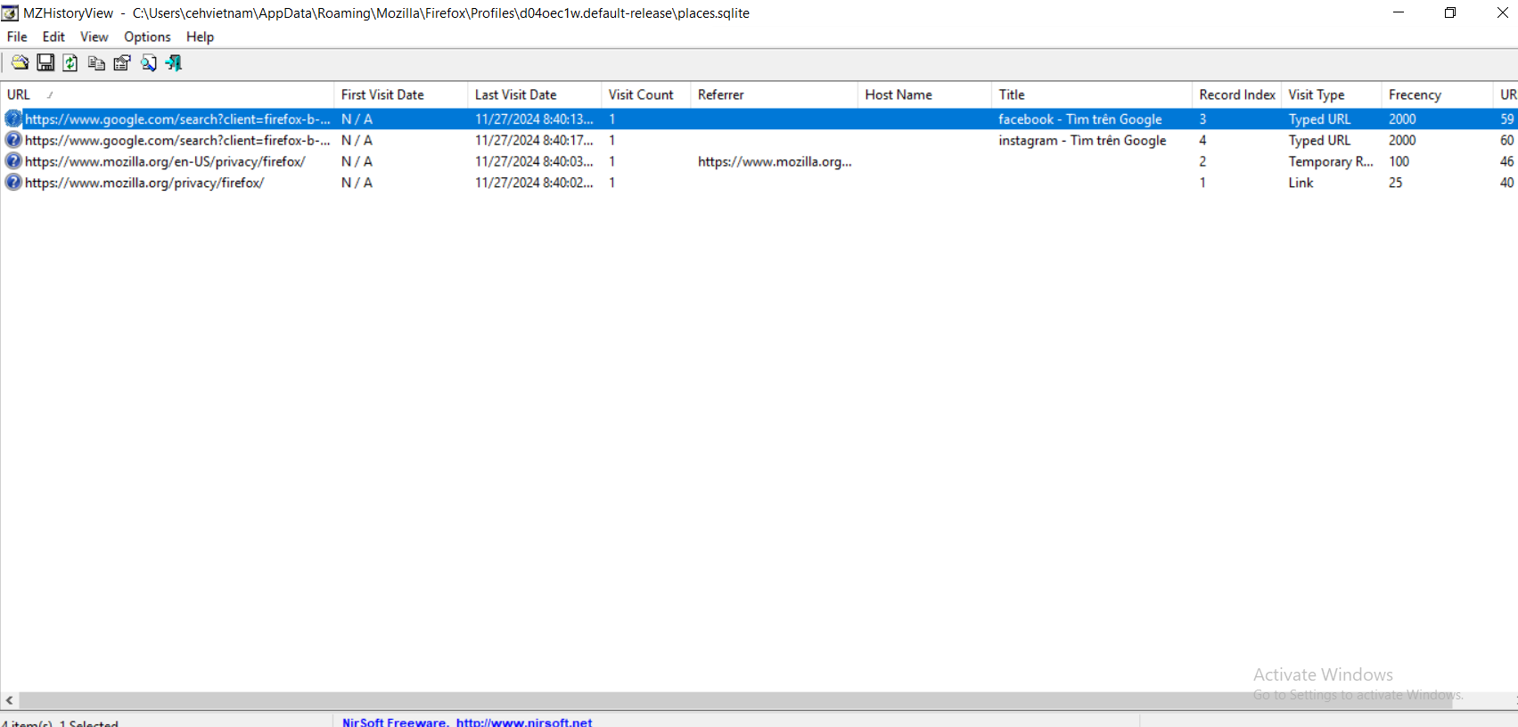
3. MZ History
Follow instruction in the labwork slide to start MZHistoryView.exe
The main application window will now appear, displaying information such as URL, First Visit Date, Last Visit Date, Visit Count, Referrer, Title, Visit Type, etc. for each visited website, as shown in the screenshot:

Slide 35
Lab 4
Discovering and Extracting Forensics data from Computers

Slide 36
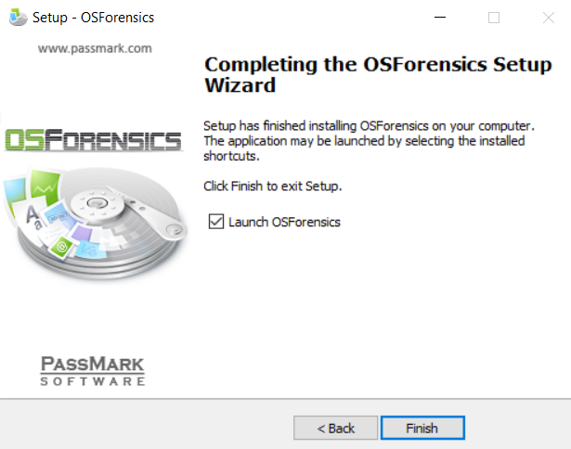
I. 1. Install OSForensics
Follow instructions in the lab work slides to install OSForensics
Click Finish to complete the installation

Slide 37
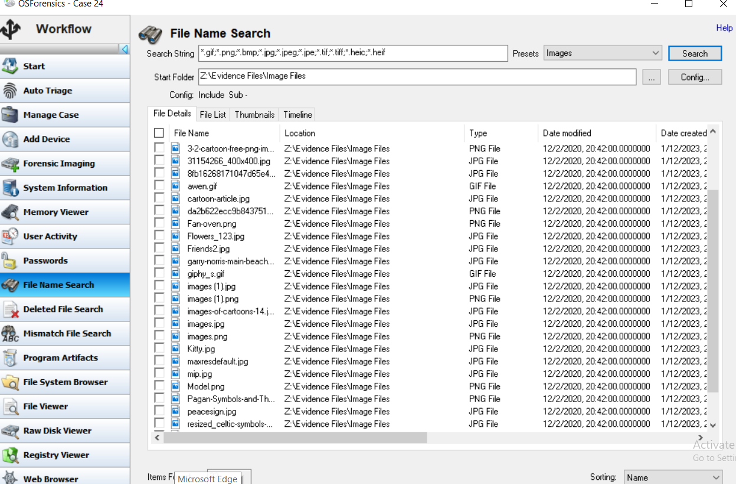
I. 2. Create case
Follow instructions in the lab work slides to create a case
In this part, we will try to search for images, follow the instructions again to search for images file using OSForensics, the result will be something like in the pictures:

Slide 38
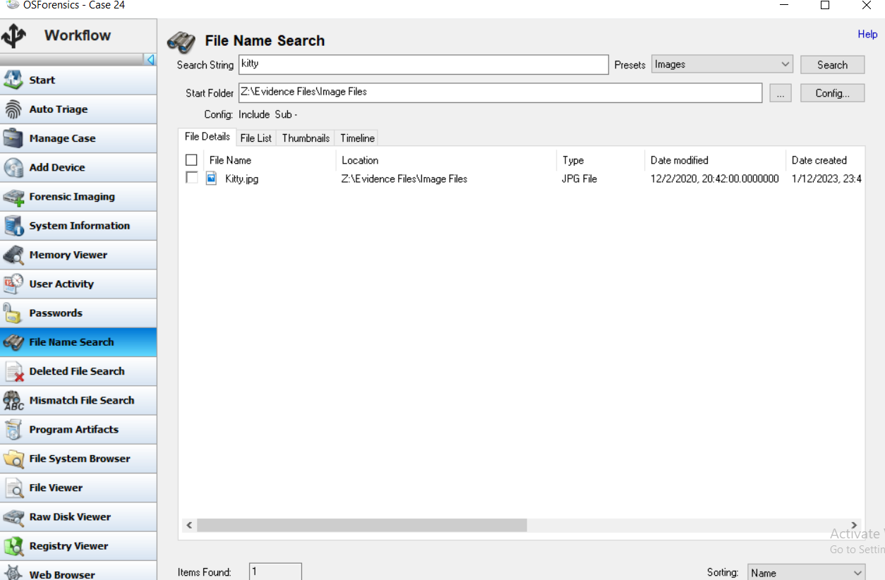
I. 2. Create case
Follow instructions in the lab work slides to create a case
In this part, we will try to search for images, follow the instructions again to search for images file using OSForensics, the result will be something like in the pictures:
We could also target a specific image file by typing the name of your desired file in the Search String box

Slide 39
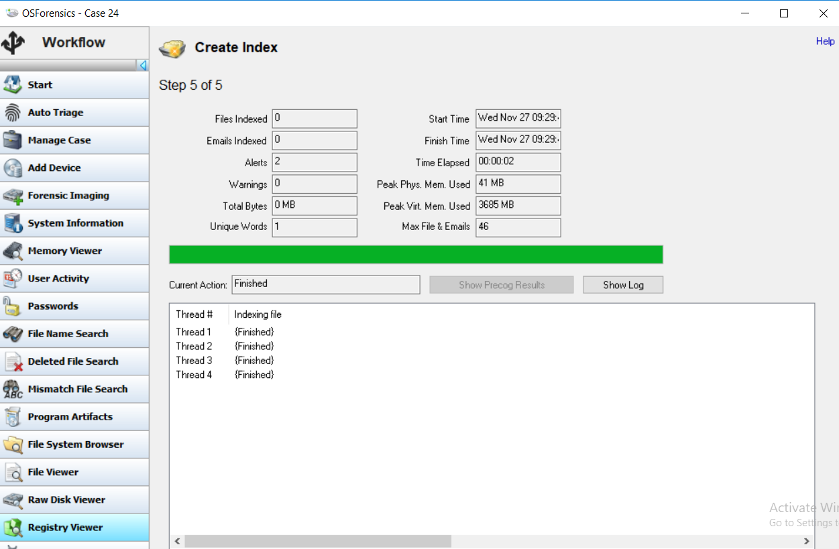
I. 3. Create index
Follow instructions in the lab work slides to create index of a file
The result will be something like this:
After successfully create an index, you can view it in Search Index as in the instructions

Slide 40
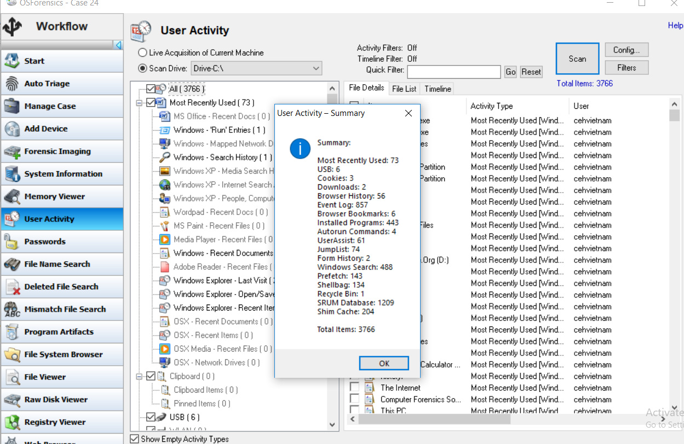
I. 4. Gather user’s activities
Follow instructions in the lab work slides to scan user’s activities
The application takes some time to scan, and upon completion of the scan, a User Activity - Summary window pops up, displaying a summary of information pertaining to user activity such as Browser History, Downloads, Most Recently Used, and Installed Programs. Click OK to close the User Activity – Summary.

Slide 41
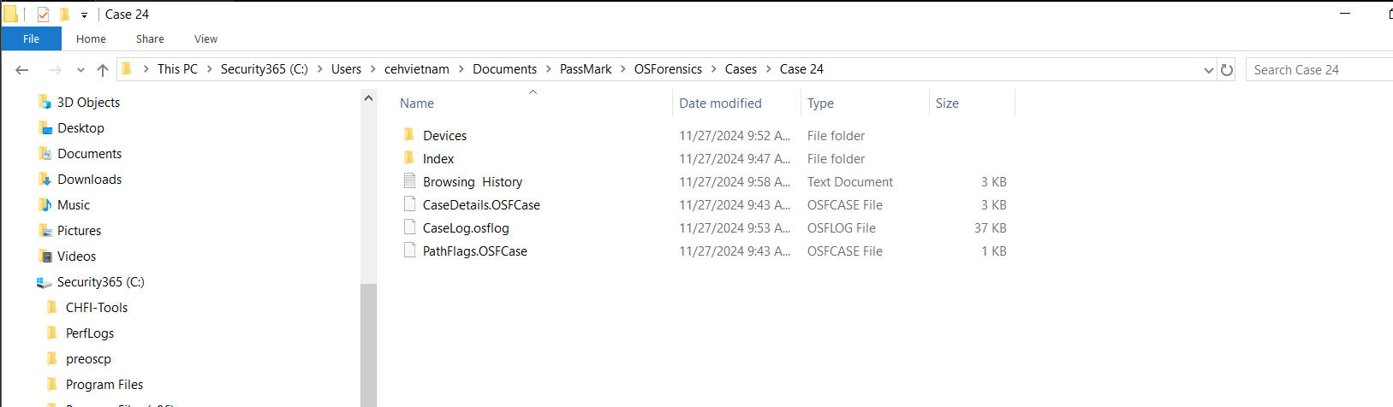
I. 5. Recover deleted files
Again, follow instructions in the slides.
After finished scanning, the application should display deleted files under Thumbnails
To save and view contents of those deleted files, you can do the same as in above steps.

Slide 42
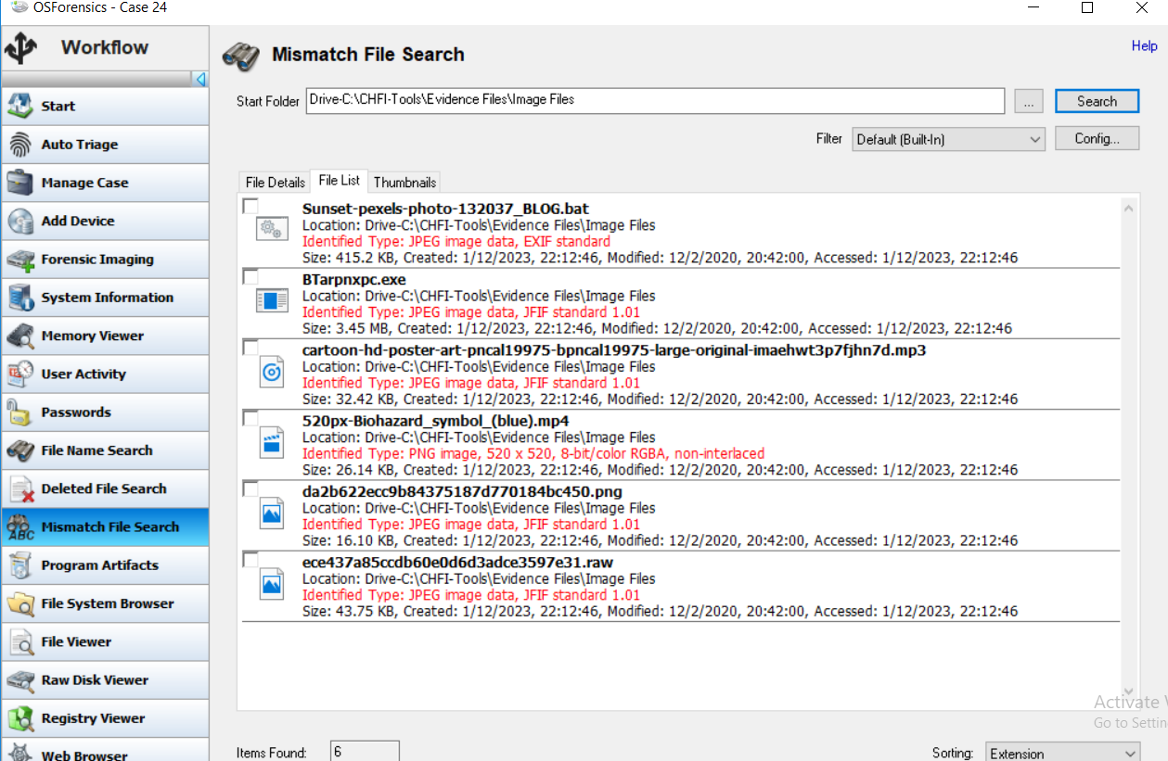
I. 6. Detected files with an extension mismatch
Again, follow instructions in the slides.
The tool will scan the selected directory and display all the files with extension mismatch under the File Details tab by default. Click on the File List tab for the ease of viewing the files and their details as shown in the following screenshot:

Slide 43
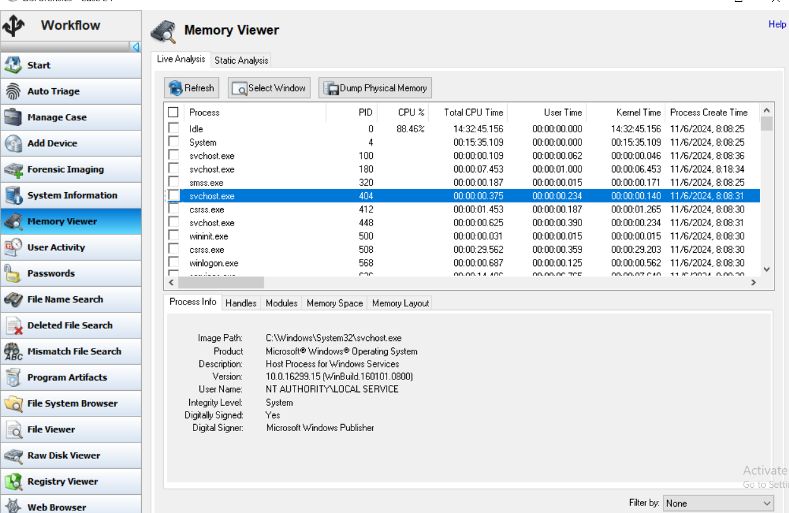
I. 7. View running process
Again, follow instructions in the slides.
To view the processes running on the system, click Memory Viewer in the left pane of the tool window. The tool will now display the Memory Viewer section.
Click on any of the process to view it’s informations

Slide 44
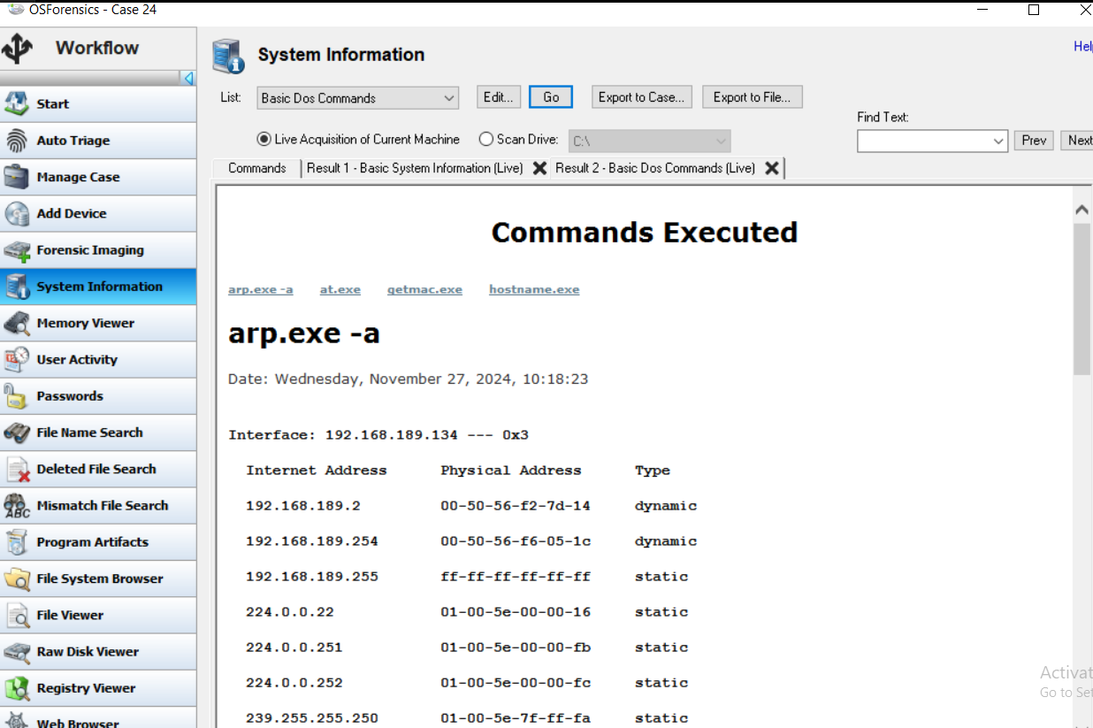
I. 8. View system information
To retrieve detailed information about the core components of the system, click System Information. The tool will display the System Information section.
Select one option then click Go, the application will display all the commands that were executed on the system and their respective outputs

Slide 45

I. 9. Verify integrity of files
To verify the integrity of files by calculating their hash values, click Verify/Create Hash from the left pane of the window. The Verify/Create Hash section will now appear in the window. Ensure that the File option is selected.
Calculate the hash of a image file that you pick, it should display results like this:

Slide 46

I. 9. Verify integrity of files
After that, follow the steps to verify if the two hash values are equal to each other.

Slide 47
Lab 5:
Extracting information about Loaded Processes on a Computer

Slide 48
Lab 5:
Lab scenario
Processes are instances of computer programs running on a system and contain the code required for activity. Any program or malware will have various methods that will combine to give the result. An investigator should know the default processes to separate them from suspicious ones and understand how to extract information about loaded processes on victim machine.
Lab objective
Understanding how to investigate loaded processes by using Process Explorer

Slide 49

Lab 5:
Step 1: After opening Process Explorer, we can check processes of DLL. In toolbar, choosing View > Lower Pane View > DLLs (or Ctrl D). Now, we have a list of processes and their details in upper pane and blank bottom pane. We need to choose a process in upper then the information about DLLs used by this process will be displayed in lower pane.

Slide 50

Lab 5:
Step 2: To view DLL properties, selecting a DLL in lower pane then go to toolbar. Choosing DLL > Properties (or Right-click on DLL), it will show the details about this DLL in Image tab, including company name, version, path…

Slide 51

Lab 5:
Step 3: On clicking Verify, if the company’s name is Microsoft Windows, then the process is determined as legitimate

Slide 52

Lab 5:
Step 4: Move to String tab, it will show the list of Unicode strings found in selected process. These strings can help to find if process associated with any malware. In this tab, we have two options Image and Memory

Slide 53

Lab 5:
Step 5: We can save the Image and/or Memory string in text file format. In this lab, we will save Image strings. Choose Image radio button then Save, specifying a location to save the file.

Slide 54

Lab 5:
Step 6: We can search for DLL on the Internet by Search Online option. Right-click on selected DLL and choose DLL > Search Online

Slide 55

Lab 5:
Step 7: To view handle of process, select process and choose View > Lower Pane View > Handle (or Ctrl H). Now, lower pane will display the handle information

Slide 56


Lab 5:
Step 8: To see handle properties, right-click on required handle and select Properties (or Handle > Properties from toolbar). Properties window will appear, including Details tab (show basis information) and Security tab (give the information about the level of security assigned to each group or user).

Slide 57
Lab 5:
In conclusion, we can view all the processes as well as their associated DLLs and handles using Process Explorer. This tool is highly useful for examining a process (any malicious process, if found) and analyzing its associated DLL files and handles.

Slide 58
Lab 6:
Viewing, Monitoring, and Analyzing Events Occurred on a Windows Machine

Slide 59
Lab 6:
Lab scenario
Attackers have infiltrated and made certain changes to the systems at the office, involving the hardware configurations, service running, operating systems and some other critical programs, to steal private and sensitive information. To solve this problem, investigators must examine all event logs pertaining to affected systems including security logs, systems logs, and applications logs to analyze.
Lab objective
Learn how to view, monitor, and analyze various event logs

Slide 60

Lab 6:
Step 1: Executing Event Log Explorer (or Ctrl O), we will use the evidence file Brute Force.evtx to examine the event logs that have been recorded on the host machine. Click Open Event Log File icon then navigating the Brute Force.evtx and click Open

Slide 61

Lab 6:
EVE application will load the selected log file and display its log entries in the right pane
The events displayed in the right pane are arranged the latest events listed at the top. Scrolling down will show older events

Slide 62

Lab 6:
When we select a particular security event, the Description pane in the lower will illustrate the details
The image indicates that system attempted to validate the credentials for Administrator’s account

Slide 63

Lab 6:
Step 2: Scroll down to see Audit Failure events
To see details that pertain to the event, double-click on event, and the Event Properties Window will appear
From the image, it shows a failed login attempt (Event ID 4625)

Slide 64

Lab 6:
Note that, there are multiple Audit Failed events followed by Audit Success events at the top showing successful login attempt. This means attackers might have attempted to login to the host/local machine using brute force attack techniques

Slide 65

Lab 6:
Step 3: If the events recorded are very large, we can use Filter. Click on Filter icon, check Audit Failure and uncheck the rest, then click OK

Slide 66

Lab 6:
Now, in the right pane, it only shows the Audit Failure
We can view the details in Description pane in the lower
In Time column, we see the first seven events bear the same time, we need exploit more here

Slide 67

Lab 6:
Description includes 3 parts:
Message “And account failed to log on”, meaning attempt to log on to local machine is fail
Subject section contains Account Name
Account For Which Logon Failed section contains the Account Name as Administrators

Slide 68
Lab 6:
Description includes 3 parts:
Message “And account failed to log on”, meaning attempt to log on to local machine is fail
Subject section contains Account Name
Account For Which Logon Failed section contains the Account Name as Administrators

Slide 69

Lab 6:
Step 4: we turn to filter Audit Success

Slide 70

Lab 6:
The image show the Audit Success only
Stick to the time in Audit Failed 6:39:28 PM, we investigate Audit Success event in the same time

Slide 71
Lab 6:
Step 5: we examine the first Audit Success event with Event ID 4776
Its Description pane reveals that computer attempted to validate the login credentials for the account Administrator on local machine

Slide 72

Lab 6:
Select the Audit Success event above (EID 4648)
Its Description pane reveals that a logon was attempted using explicit credentials on the local machine
This might occur when an attacker/malicious user has got hold of the login credentials for a local machine.

Slide 73

Lab 6:
Select the Audit Success event above (EID 4624)
Its Description pane reveals that an account was successfully logged onto

Slide 74

Lab 6:
Select the Audit Success event above (EID 4624)
Further scrolling down in the Description pane reveals the account name (here, it is Administrator) on which the successful login occurred,

Slide 75

Lab 6:
Select the Audit Success event above (EID 4672)
Its Category field mentions Special Logon. The Description pane for this event, at the very top, reveals that special privileges have been assigned to the new logon

Slide 76

Lab 6:
Step 6: We can Save the Audit Failure and Audit Success event log
Filter out both Audit Failure and Audit Success. Then choose File > Save Log As… > Save Event Log (Backup)…

Slide 77
Lab 7: Performing Digital Forensic Investigation on a Computer
Lab scenario: When a cyber-security breach occurs in an organization, network security administrators should be able to aptly respond to the situation and take the necessary steps to avoid further damage. In case there are no professional incident response personnel to respond to the situation, the company would hire an investigator for incident response.
Lab Objectives: The objective of this lab is to help you learn how to investigate cyber-crimes using the Helix tool.
Lab Environment:
A computer running Windows 10 virtual machine
Administrative privileges to execute the commands
A web browser with internet access
Helix installer located at C:\CHFI-Tools\CHFIv10 Module 06 Windows Forensics\Windows Forensics Tools\Helix

Slide 78


Step 1: Run Helix
Click accept to run Helix
After accepting, a window of Helix will appear like this. Now let click on Preview System Infomation

Slide 79


Step 1: Run Helix
Now let click on the Acquire button (camera icon) to start acquire physical memory or disk drives.
We can see the computer’s system information here. Now click on the triangle button to see the processes that are running on the computer

Slide 80


Step 1: Run Helix
Now let move to the second page and click Imager button
A window of Live Acquisition will appear like this, we will be demonstrating the steps to create/acquire the forensic
image of a logical drive (here, the C: Drive).

Slide 81




Step 2: Start creating Disk Image
Following these step and continue
Helix will now launch the Access Data FTK Imager application. Go to
File → Create Disk Image….

Slide 82



Step 2: Start creating Disk Image
This window will appear, now we have to choose a destination, image fragment size and fill in filename to start create a disk image
Then click Add and choose Raw (dd) and click Next. An Evidence Item Information window will appear, we will have to fill in the information and click Next to continue

Slide 83


Step 2: Start creating Disk Image
Click Start to start creating Disk Image. The tool will now start creating the image.
When the imaging is complete, the application will save the logical drive image fragments to
the destination folder, i.e., Helix Forensic Images in the Documents directory. You can monitor the progress of the image creation in the Progress section of the Creating Image… window,

Slide 84


Step 2: Start creating Disk Image
For the purpose of this task, as we are focusing on demonstrating the steps to create a logical drive image, we will abort the imaging process by clicking Cancel and then Yes when the FTK Imager window appear.
The application will now abort the imaging process. Close the Creating Image… window by clicking Close.

Slide 85



Step 3: Investigating a forensic image file
Get back to the AccessData FTK Imager, now click on File and Choose “Add Evidence Item”
Now we will choose Image File and click Next to start browsing Image File for investigating. In this lab, we will be analyzing Windows_Evidence_001.dd

Slide 86




Step 3: Investigating a forensic image file
The image file is displayed in the left pane of the tool window. Now, expand Windows_Evidence_001.dd → Evidence [NTFS] → [root] and click on the Images folder.
To view the properties of the image file, click the Properties tab in the lower section of the left pane in the tool window. Similarly, you can view the Hex Value Integer and Custom Content Sources tabs, which are located next to the Properties tab, by clicking on them

Slide 87


Step 4: Run Nigilant 32
In this manner, you can create or view images using the AccessData FTK Imager application. Now, close the application. In the left pane of the Helix window, click the Incident Response icon. Then Click the Agile RiskManagement’s Nigilant32 icon on Page 1 of this section.
The Nigilant 32 pop-up appears. Click on the pop-up.

Slide 88



Step 4: Run Nigilant 32
The Nigilant32 - Windows Afterdark Forensic window appears
Choose File → Preview Disk… to see a preview of the hard drives. Select the drive to preview and then click the Apply button. Here, we are selecting the first drive.

Slide 89



Step 4: Run Nigilant 32
The tool now displays the files and folders pertaining to the partition. Double-click a file to view its hex-equivalent data in the lower pane of the window. Here, we have double-clicked on $MFTMirr to view its contents.
To take a snapshot of the computer, choose Tools → Snapshot Computer. The tool will display the Live Machine Snapshot window. If you wish to save the snapshot, click the Save button.

Slide 90


Step 5: Check MD5 Hash and Virus Total
Now, close the Nigilant32 - Windows Afterdark Forensic window and return to the main window of Helix. Click the arrow icon against the Incident Response section to move to its second page,
The second page of the Incident Response section contains the FILE and MD5 fields. In this task, we are going to check a file’s hash and its legitimacy. We will first calculate the file’s hash and then search for that file or its hash in the VirusTotal database.

Slide 91


Step 5: Check MD5 Hash and Virus Total
Click the ellipsis button against the FILE field to provide an evidence file as input. A Select File window will appear. Navigate to C:\CHFITools\ Evidence Files, select the file Infected.docx, and then click Open. Subsequently, click on the Hash button to generate the MD5 hash value of the Infected.docx file.
Now, we will look up the VirusTotal database to determine whether the file is safe or malicious.

Slide 92
Step 1: Run Helix
Click accept to run Helix
After accepting, a window of Helix will appear like this. Now let click on Preview System Infomation

Slide 93


Step 6: Recovering deleted files
Select drive and Click on the tick icon to start read the disk and recover file.
In the left pane of the window, the tool will display a tree structure under the Folders section. In this section, click the Deleted items option. All the deleted items will appear here

Slide 94



Step 6: Recovering deleted files
To recover a deleted a file, select the desired file and then click the Save icon on the left of the tool window
Upon clicking the Save icon, a Select Directory… window will appear. Choose the directory to which you wish to save the selected deleted file. Here, we are saving the file to the default location, i.e., Desktop. Click the tick mark icon after choosing the location for saving the file,

Slide 95


Step 7: Browsing contents on a hard drive
To find the contents of the system’s hard drive, return to the main window of Helix and click the Browse icon in the left pane. This
operation lists all the drives of the system in the middle pane of the window.
Click on one of the listed drives to find its node on the left and then expand the node. The tool will display all the folders stored within the selected drive

Slide 96


Step 7: Browsing contents on a hard drive
Here, we are expanding the node against the folder CHFI-Tools and then further expanding the node against the sub-folder Evidence Files. Under the Evidence Files sub-folder, click the Image Files folder to see its contents in the right pane of the tool window
Now, select an image file in the right pane. The application displays the file’s properties in the lower-right section of the window.

Slide 97



Step 8: Scan for pictures
To scan images or pictures on the computer, click the Scan for Pictures icon and then click Load Folder to view the images.
A Browse For Folder window appears. Navigate to C:\CHFITools\Evidence Files\Image Files to load the pictures for scan and then click OK. A Notice pop-up appears, asking you to be patient. Click OK.

Slide 98


Step 8: Browsing contents on a hard drive
The tool will load the previews of all images within the folder
In this manner, you can create images, retrieve deleted files, and scan for
image files on a computer by using Helix.

Slide 99
Lab 8: Collecting and Parsing Forensic Artifacts on a Live Windows Machine
Lab scenario: The employee complained that some confidential files were missing from his system. Robert enquired further and learnt that most of the sensitive files were stored in the system drive of the machine. Using the KAPE tool, even before the full system image was taken, so that he could start the forensic analysis at the earliest.
Lab Objectives: This lab will help you understand how to identify and collect forensically useful artifacts from a Windows machine and parse them simultaneously to expedite the investigation.
Lab Environment:
A computer running Windows 10 virtual machine
Administrative privileges to execute the commands
A web browser with internet access
KAPE tool located at C:\CHFI-Tools\CHFIv10 Module 06 Windows Forensics\Windows Forensics Tools\KAPE

Slide 100


Step 1: Run KAPE
After running KAPE, a window will appear like this
Click on the tickbox of Use Target options

Slide 101

Step 1: Run KAPE
A. Target source: Here, you can specify the drive letter you wish to
collect the files from. In this lab, we will be selecting the C: or system drive.
B. Target destination: This is the location where the collected files will be stored. For live collection, it should usually include the path to an external drive. However, as it is a lab scenario, we will be saving the tool outputs in the C: drive itself.
C. Targets: This is the location from which you can select the types of files that the tool will collect. It includes an extensive list of Targets that you can select and edit as per the case requirements.
D. Deduplicate: With this option checked, KAPE will remove any
duplicate file by matching their SHA 1 hash values. This option is
already checked by default.
E. Container: This field determines the format in which files will be collected. Available formats for use are VDHX, VHD, and Zip.
F. Flush: This option flushes or removes the contents of the Target destination before collecting any data. This option is checked by default.

Slide 102


Step 1: Run KAPE
A. Module source: Here, the path of the Target destination where you
copied the files should be mentioned.
B. Module destination: Here, the folder path is to be specified where the parsed copies of the Target files will be saved.
C. Modules: This section contains the names of the Modules belonging to specific executables, using which the selected Target files will be parsed. These executables are stored in the bin folder of the KAPE tool.
D. Flush: The Flush option is checked by default. It flushes the contents of the Target/Module destinations before storing/parsing any data.
E. Export Format: This section specifies the format in which the parsed data will be generated. The default option is the CSV format, along with HTML and JSON.

Slide 103


Step 1: Run KAPE
A. Current command line: This is the command line section of the tool. Any commands provided in the tool is recorded in this section.
B. Copy Command: This button helps in copying the command from the Current command line and run it on Command Prompt.
C. Sync with GitHub: Clicking this button draws updated Targets and Modules from the GitHub repository. However, the required executables need to be downloaded and placed in the KAPE/bin folder manually.
D. Execute!: On selecting all the desired Targets/Modules and setting the folder path for Target and Module sources and destinations, you can click on the Execute! button to executes the command.

Slide 104

Step 2: Create KAPE Output
Now, we need to create the Target and Module destination folders, which will be required while running the tool.
Minimize the KAPE GUI window. Open File Explorer, navigate to This PC → CEHVIETNAM (Z:), and create a new folder named KAPE Output.

Slide 105

Step 2: Create KAPE Output
Now, go inside the KAPE Output folder. Create two folders named KAPE Target Output (this folder will be used as the Target destination) and KAPE Module Output (this folder will be used as the Module destination).
Now, we can create Target files by copying files from the machine. To do so, return to the KAPE GUI window.

Slide 106


Step 3: Start creating Target options
Now, we can create Target files by copying files from the machine. To do so, return to the KAPE GUI window.
Ensure that the Use Target options entry is checked. To select the Target source folder, click on the Ellipsis (…) beside it.
Note: Ensure that you uncheck Use Module options in case it is checked
The Browse for Folder window appears. Select Local Disk (C:) and Click OK.

Slide 107


Step 3: Start creating Target options
Similarly, to set the Target destination folder, click on the Ellipsis (…) button beside it. When the Browse For Folder window appears, navigate to Local Disk (C:) → KAPE Output → KAPE Target Output. Once done, click OK.

Slide 108

Step 3: Start creating Target options
In the Targets section, we will select Targets related to Filesystem, LNK files, and Jump Lists. To find Filesystem related Targets, place the cursor below the Name field beside the letters RBC and type FileSystem. Once the Target entry named FileSystem is found, select the checkbox associated with it.

Slide 109


Step 3: Start creating Target options
Now, double-click on the Target entry named FileSystem to view its contents or edit it.

Slide 110

Step 3: Start creating Target options
A. $MFT: Also known as Master File Table, this file contains a series of attributes for each file in the specified file system and is of utmost forensic value.
B. $LogFile: This file tracks changes made in the NTFS filesystem.
C. $J: This file is a part of the $UsnJrnl file, which includes the contents of the change journal.
D. $SDS: Also known as Security Descriptor Stream, this file stores a list of all Security Descriptors in the NTFS volume.
E. $Boot: This is the file copy of the boot sector of the specified NTFS volume.
F. $T: This file belongs to TxF Old Page Stream (TOPS) file data. It includes the $T data stream, which contains data about files that are partially overwritten.

Slide 111

Step 3: Start creating Target options
Close the Editor: FileSystem window. Now, In the Target section, clear the RBC cell, type LnkFilesAndJumpLists and select the checkbox associated with LnkFilesAndJumpLists. This Target entry would copy LNK files and Jump Lists from the specified drive.
Ensure that the Flush and Deduplicate options are checked, and keep the Container selected as None.

Slide 112


Step 3: Start creating Target options
Once both the Target entries are selected, the Current command line section would appear
In the highlighted section of the screenshot above, the --tsource parameter specifies the Target source folder, and the --tdest parameter defines thepath of the Target destination folder. The --tflush parameter indicates that the Flush option is checked, the --target parameter shows the selected
Target entries, and the --gui parameter indicates that the command will to be executed using the GUI of the tool.
Once the Target options are all configured, click on the Execute! button

Slide 113

Step 3: Start creating Target options
The tool will now open a command-line window showing the progress of the Target files being copied. Once all the selected Target files are copied to the Target destination folder, the tool will prompt you to press any key to exit.
Note: If a DATA DESTRUCTION WARNING! window appears, click OK to continue.

Slide 114

Step 3: Start creating Target options
The tool will now open a command-line window showing the progress of the Target files being copied. Once all the selected Target files are copied to the Target destination folder, the tool will prompt you to press any key to exit.
Note: The tool takes some time to copy the selected Target files

Slide 115

Step 4: Investigating Target Output
Now, open File Explorer and navigate to C:\KAPE Output\KAPE Target Output. You will see a folder called C, along with three files
All the files in the highlighted section of the above screenshot start with the date when the Target files were copied from the machine, followed by some alphanumerical characters. The file 2020-10 -16T181354_ConsoleLog.txt bears the same information as what was displayed in the command-line window, the file 2020-10-16T181354_CopyLog.csv includes information about the Target files that were copied, and the file 2020-10-16T181354_SkipLog.csv includes information about the Target files that were skipped during the Target operations by the tool.

Slide 116


Step 4: Investigating Target Output
To view the copied items, double-click the C folder. You will see some of the copied files, namely, $Boot, $LogFile, $MFT, and $Secure, $SDS, and two folders: $Extend and users.
You will also observe the files $J and $Max as well as a folder called $RmMetadata upon double-clicking the $Extend folder.

Slide 117

Step 4: Investigating Target Output
Now, navigate to $RmMetadata → $TxfLog. You will see the $T file there.
Note: The change journal file in NTFS filesystem named $UsnJrnl is stored in a hidden folder named $Extend and contains two alternate data streams named $J and $Max. Copying the $J file via the KAPE will also copy the $Max file, along with its full path.

Slide 118


Step 4: Investigating Target Output
Now, return to the Microsoft folder and navigate to Windows\Recent. You will see two folders named AutomaticDestinations and CustomDestinations (A) that contain the list of all Jump List files, along with a list of LNK files (B)

Slide 119

Step 4: Investigating Target Output
Go to both AutomaticDestinations and CustomDestinations folders to view the lists of copied Jump Lists files

Slide 120

Step 4: Investigating Target Output
Note: Depending on the usage, you may also locate Target LNK files in the C:\KAPE Output\KAPE Target Output\C\users\Public\Desktop folder or C:\KAPE Output\KAPE Target Output\C\users\Administrator\Desktop folder

Slide 121

Step 5: Create Module Output
As the chosen Target files are already acquired, we will now use the same application to parse these files and examine their contents. To do so, maximize the KAPE GUI window.
Ensure that you have unchecked Use Target options on the top-left corner of the tool. This will disable all the Target options. Now, click on Use Module options to enable it

Slide 122


Step 4: Investigating Target Output
The Browse for Folder window appears. Navigate to Local Drive (C:) → KAPE Output → KAPE Target Output and select it. This will enable you to parse the acquired Target files. Once configured, click OK.

Slide 123


Step 5: Create Module Output
Now click on the Ellipsis (…) button beside Module destination
On the Browse for Folder window that appears next, navigate to Local Drive (C:) → KAPE Output → KAPE Module Output, select it, and click OK

Slide 124

Step 5: Create Module Output
Now, we will select the Modules from the Modules section, using which we want to parse our Target files. In this lab, we will be demonstrating how to parse the $MFT Target file, along with the LNK files and Jump Lists acquired in the KAPE Target Output folder.
To parse the $MFT Target file, we will choose a Module named MFTECmd_$MFT. So, in the Module section, place the cursor below the Name section beside the letters RBC and type MFTECmd_$MFT. When the Module with the same name appears, select the checkbox associated with the module,

Slide 125

Step 5: Create Module Output
Now double-click on the MFTECmd_$MFT module to determine what executable will be running via the Module to parse the $MFT Target file.

Slide 126

Step 5: Create Module Output
Close the MFTECmd_$MFT window. Now, we will select a Module to parse the Jump Lists stored in the KAPE Target Output folder. For the Jump Lists, type JLECmd. A Module entry with the same name will appear. Select the checkbox associated with the module and then double-click it to view the name of the executable contained in that Module

Slide 127

Step 5: Create Module Output
An Editor: JLECmd window opens. It shows that the executable name to be used for parsing the Jump List files is JLECmd.exe, along with the CommandLine and ExportFormat.

Slide 128


Step 5: Create Module Output
Close the Editor: JLECmd window. Type LECmd and select the checkbox for the Module entry with the same name when it appears. Now, doubleclick on the entry. This Module will be used for parsing the LNK files in the KAPE Target Output folder.

Slide 129


Step 5: Create Module Output
Close the Editor: JLECmd window. Type LECmd and select the checkbox for the Module entry with the same name when it appears. Now, doubleclick on the entry. This Module will be used for parsing the LNK files in the KAPE Target Output folder.

Slide 130


Step 5: Create Module Output
The Editor: LECmd window that appears shows the executable name as LECmd.exe, along with the CommandLine and ExportFormat.

Slide 131

Step 5: Create Module Output
Close the Editor: LECmd window. The required Modules are all selected. Ensure that the Flush option is checked and choose CSV as the Export format

Slide 132


Step 5: Create Module Output
With all configurations done in the Modules section, the Currentcommand line will look like the following
Current command line as shown above, the --msource parameter reflects the path of the selected Module source folder, the --mdest parameter displays the path of the selected Module destination folder, --mflush shows that the contents of the selected Module destination folder will be flushed prior to parsing, the –module parameter shows the Modules that are selected, the --mef parameter shows the Export format chosen, and --gui shows that the command line will be executed via the KAPE GUI
Once configured and reviewed, click on the Execute! button.

Slide 133

Step 5: Create Module Output
The tool will now open a command-line window showing the progress of the Modules being run against the Target files stored in the KAPE Target Output folder. When the parsing is done, the tool will prompt you to press any key to exit the command-line window

Slide 134

Step 5: Create Module Output
The tool will now open a command-line window showing the progress of the Modules being run against the Target files stored in the KAPE Target Output folder. When the parsing is done, the tool will prompt you to press any key to exit the command-line window

Slide 135


Step 6: Investigating Module Output
Now, open File Explorer and navigate to C:\KAPE Output\KAPE Module Output. You will see two folders: FileFolderAccess and FileSystem, along with one text file named 2020-10-16T182016_ConsoleLog.txt
Double-click the FileSystem folder and you will see a file named 20201016182035_MFTECmd_$MFT_Output.csv. This is the CSV file that was generated after parsing the $MFT Target file.

Slide 136
Step 6: Investigating Module Output
Note: The first 8 numbers in the filename highlighted above shows the date on which it was parsed in the yyyymmdd format. These numbers may differ in your lab environment.
Note: You might need to sign in and activate Microsoft Office to in order to perform all the subsequent steps in this lab that involve Microsoft Office Excel application.

Slide 137

Step 6: Investigating Module Output
Double-click on the CSV file to open and view its contents.
Note: You may need to adjust the size and width of rows and columns for a better view.

Slide 138

Step 6: Investigating Module Output
Select the entire top row, go to the Views tab, click on Freeze Panes, and select Freeze Top Row from the drop-down menu.

Slide 139

Step 6: Investigating Module Output
Ensure that the top row is selected. Now, return to the Home Tab. Click on the B icon to view the top row in bold.
Note: We will be using this formatting for the rest of the .CSV files as well in this lab.

Slide 140

Step 6: Investigating Module Output
Scroll down to view all the files inside the $MFT files. Drag the horizontal scroll bar to the right to find many notable entries about the files reflected in the parsed $MFT file, such as their ParentPath (A) or their location in the NTFS file system, FileName or name of the files (B), their Extension (C), and FileSize (D).

Slide 141

Step 6: Investigating Module Output
On dragging the horizontal scroll bar further to the right, you will observe Created0x10 (E) and Created0x30 (F), which represent the creation date and time of any file; LastModified0x10 (G) and LastModified0x30 (H),which represent the last modified date and time of any file; andLastRecordChange0x10 (I) and LastRecordChange0x30 (J), which represent the date and time when any change was recorded in any file

Slide 142

Step 6: Investigating Module Output
Upon dragging the horizontal slider further to the right, you can observe other entries such as LastAccess0x10 (K) and LastAccess0x30 (L), which represent the last access date and time of any file, along with the UpdateSequenceNumber (M), LogFileSequenceNumber (N), and SecurityId (O)

Slide 143

Step 6: Investigating Module Output
These entries are very important from a forensic point of view as you can identify and examine the last access and modified time of any specific file in the NTFS file system of the suspect machine. The $MFT file also holds information about files that are deleted, and its examination can help in the recovery of such files.
Upon examining the entries, close the 20201016182035_MFTECmd_$MFT_Output.csv file.
On File Explorer, navigate to C:\KAPE Output\KAPE Module Output\FileFolderAccess and you will see three .csv files: 20201016112054_AutomaticDestinations.csv and 20201016112055_CustomDestinations.csv, which contain information about parsed Jump Lists, and 20201016112056_LECmd_Output.csv, which contains details about parsed LNK files from the KAPE Target Output folder

Slide 144

Step 6: Investigating Module Output
We will first examine the Jump List files in 20201016112054_AutomaticDestinations.csv file. Double-click the file to open and view its contents

Slide 145

Step 6: Investigating Module Output
Some of the notable entries found in the 20201016112054_AutomaticDestinations.csv file are SourceFile or the path of the Module source (A), SourceCreated, SourceModified, SourceAccessed (B) APPId information (C), path of the target Jump Lists (D), TargetCreated, TargetModified and TargetAccessed date and time (E), and FileSize (F)

Slide 146

Step 6: Investigating Module Output
Some of the notable entries found in the 20201016112054_AutomaticDestinations.csv file are SourceFile or the path of the Module source (A), SourceCreated, SourceModified, SourceAccessed (B) APPId information (C), path of the target Jump Lists (D), TargetCreated, TargetModified and TargetAccessed date and time (E), and FileSize (F)

Slide 147

Step 6: Investigating Module Output
On opening the 20201016112055_CustomDestinations.csv file, you will receive similar type of information as found in the 20201016112054_AutomaticDestinations.csv file.

Slide 148



Step 6: Investigating Module Output
Examine all the Jump Lists in the 20201016112055_CustomDestinations.csv and close the file without saving
Now, open the 20201016112056_LECmd_Output.csv file. You will see notable entries such as SourceFile (A), SourceCreated, SourceModified and SourceAccessed–related Timestamps (B), TargetCreated, TargetModified, and TargetAccessed–related Timestamps (C), FileSize (D), RelativePath (E), TargetIDAbsolutePath (F), TargetMFTEntryNumber (G), TargetMFTSequenceNumber (H), MachineID (I), and MachineMACAddress (J)

Slide 149

Step 6: Investigating Module Output
The examination of these entries about the LNK files and Jump Lists can provide useful information about the user activities on the system
Thus, you can use the KAPE tool to acquire and process forensically valuable data and expedite the investigation

